Slide 1
WELCOME to CS244
Data Structures
A speck of dust?
I’ve seen a few.
But
What kind?
How many?
With what else?
In what order?
Let’s Get Organized.
Brent M. Dingle, Ph.D. 2014
Game Design and Development Program
Mathematics, Statistics and Computer Science
University of Wisconsin - Stout

Slide 2
Your Instructor
Brent Dingle, Ph.D.
Office: JHSW, Room 219
Office Hours (tentative)
Tuesday/Thursday: 10:00 AM – 11:30 AM
Wednesday: 1:30 PM – 2:30 PM
Office Phone: N/A
Email: dingleb@uwstout.edu
Course Info: Check online D2L
Syllabus is also online

Slide 3
In Case of Emergency
Locate the exit door
Note the exit paths
If the door cannot be located
it’s too late

Slide 4
In Case of Potty Emergency
Locate the exit door
Note the path to the restroom
If the door cannot be located
it’s too late

Slide 5
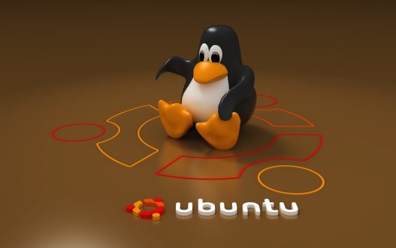
Plan for the Day
Get Software Needed
Install Vmware Player and/with Ubuntu
Instructor Background
Syllabus Stuff

Slide 6
USB drives Circulating
As I talk
Circulate the USB drives amongst yourselves
Copy all the files to your Documents Directory (or perhaps a CS244 subdirectory thereof)
Further directions will follow towards end of class
when everyone has copied the files over
hint: run the installation file for VMware player

Slide 7
What I used to do

Slide 8
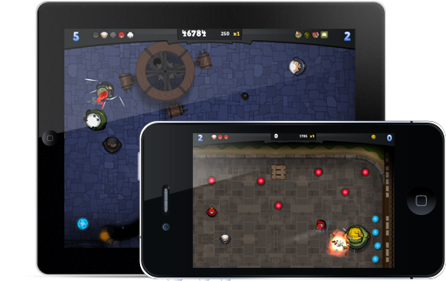
Oh, and I made some Games

Slide 9
Instructor Background
High Expectations
What you can achieve is limited only by
What you want to accomplish (desire)
What you expect to accomplish (resolve)
What you will achieve is often determined by
How hard you are willing to work (dedication)
My expectations of you are high
You will be challenged

Slide 10
Syllabus
Can be found on D2L
Highlights follow

Slide 11
Assumptions – New for this Year
You already know C++
This knowledge will be tested (repeatedly)
Book may help
book is also new this semester

Slide 12
Course Objectives
Introduction to common abstract data types and their associated algorithms
Stacks, queues, lists, trees, sorting, searching…
Practice applying and using them
Be able to select the appropriate data type and algorithm for given situations and problems
Be able to compare the efficiency of various implementations and algorithms
i.e. the pros and cons of one way versus another
Use object-oriented design for purposes of data abstraction and encapsulation
Develop software engineering skills

Slide 13
Course Objectives
Introduction to common abstract data types and their associated algorithms
Stacks, queues, lists, trees, sorting, searching…
Practice applying and using them
Be able to select the appropriate data type and algorithm for given situations and problems
Be able to compare the efficiency of various implementations and algorithms
i.e. the pros and cons of one way versus another
Use object-oriented design for purposes of data abstraction and encapsulation
Develop software engineering skills

Slide 14
Course Objectives
Introduction to common abstract data types and their associated algorithms
Stacks, queues, lists, trees, sorting, searching…
Practice applying and using them
Be able to select the appropriate data type and algorithm for given situations and problems
Be able to compare the efficiency of various implementations and algorithms
i.e. the pros and cons of one way versus another
Use object-oriented design for purposes of data abstraction and encapsulation
Develop software engineering skills

Slide 15
Course Objectives
Introduction to common abstract data types and their associated algorithms
Stacks, queues, lists, trees, sorting, searching…
Practice applying and using them
Be able to select the appropriate data type and algorithm for given situations and problems
Be able to compare the efficiency of various implementations and algorithms
i.e. the pros and cons of one way versus another
Use object-oriented design for purposes of data abstraction and encapsulation
Develop software engineering skills

Slide 16
Course Objectives
Introduction to common abstract data types and their associated algorithms
Stacks, queues, lists, trees, sorting, searching…
Practice applying and using them
Be able to select the appropriate data type and algorithm for given situations and problems
Be able to compare the efficiency of various implementations and algorithms
i.e. the pros and cons of one way versus another
Use object-oriented design for purposes of data abstraction and encapsulation
Develop software engineering skills
with data abstraction

Slide 17
Outcomes
By the end of this course, you will be able to
Select and implement appropriate data structures and algorithms for a given problem
Be able to defend your choice by understanding and applying Big-Oh asymptotic analysis and reasoning

Slide 18
General Classroom Etiquette
Come to every class
You are responsible for all material presented and assignments given
Be courteous to your fellow classmates
and the instructor
Bring your laptops
Turn off cell phones
see syllabus for more explicit details

Slide 19
Special Needs
If you anticipate or experience any barriers related to the format or requirements of the course
Let me know
after class, office hours, appointment
see syllabus for additional details

Slide 20
Academic Dishonesty
Do NOT cheat
It won’t help
and you should find NO need for it
see syllabus for additional details

Slide 21
Course Type
Lecture and “Lab-like”
Instructor Presentation
Opportunities to apply what was talked about
discussions
coding
group and individual activities
Sometimes live/improv demos

Slide 22
Semester Structure
The course will be divided into 3 “units”
Each unit
Builds from the previous
Has homework assignments
Has in-class assignments
Ends with a test (usually paper based and in-class)

Slide 23
Grading Structure
76% Tests
24% Homework In-Class assignments/work/participation

Slide 24
Letter Grades
Percentage Score to Letter Grade Table
A weighted grade of: | 96% or above will earn you at least an A | 72% or above at least a C
 | 92% or above at least an A- | 68% or above at least a C-
 | 88% or above at least a B+ | 64% or above at least a D+
 | 84% or above at least a B | 60% or above at least a D
 | 80% or above at least a B- | 56% or above at least a D-
 | 76% or above at least a C+ | Below 56% is an F

Slide 25
Tentative Schedule (subject to change as needed)
Date | Event
Sep 11 | Test Zero
Sep 18 | HW #1 due + Peer Review
Sep 25 | HW #2 due + Peer Review
Oct 2 | HW #3 due + Peer Review
Oct 9 | HW #4 due + Peer Review
Oct 14 | HW #5 due + Peer Review
Oct 16 | Test 1
Oct 28 | HW #6 due + Peer Review
Nov 4 | HW #7 due + Peer Review
Nov 11 | HW #8 due + Peer Review
Nov 13 | Test 2
Nov 25 | HW #9 due + Peer Review
Dec 9 | HW #10 due + Peer Review
Dec 15 | MONDAY, 10:00-11:50 a.m. Test 3 (verify with University Calendar)
Peer Reviews occur
at discretion of Instructor
Assume every homework has
one or something similar
Questions? Concerns?

Slide 26
Homework Grading
Peer Review of Code
Expected skill in the workforce
Practice is good
Seeing how other people code is also good
Being able to read other’s code is a necessity
. .
. .
.
. .
.
.

Slide 27
Homework Grading
Turning in Stuff Late will be penalized
Minimally:
You miss the opportunity to have it reviewed
So if it was to receive 2 peer reviews + instructor eval
then assume you get (0 + 0 + instructor eval) / 3
or worse
Peer Review of Code
Expected skill in the workforce
Practice is good
Seeing how other people code is also good
Being able to read other’s code is a necessity
Peer reviews (or similar) will be done in-class usually the day the homework is due
Failure to participate in the peer review process will result in a zero for your peer review grade
and may result in a zero for your assignment grade
Check with instructor if you know you will be missing class ahead of time
Part of your homework grade will be based on peer review evaluations of your work
Final determination and assignment rests with the class instructor

Slide 28
End Syllabus
Questions about the syllabus or related?
More info
on course details follows
Go to next slide

Slide 29
Virtual Machine Demo
Class requires you to program in
C++
Using Standard Template Libraries (STL)
So you need a C++ compiler with STL
Solution is to Install and Use
VMware Player
Ubuntu Linux Virtual Machine
GNU C++, aka g++
Switch over and demonstrate, then come back

Slide 30
VM Demo Summary
The goal of installing VMware Player and an Ubuntu Linux Virtual Machine is so we can write C++ programs
In D2L you will find documents on
How to navigate folders in a terminal/command window
How to compile a C++ file in a terminal/command window
Some of you may finish this installation before others SO… feel free to explore Ubuntu Linux
the above documents may help.
So now, a class activity… (next page)

Slide 31
Class Activity: Installing Stuff
Install VMware Player
Install Ubuntu Linux (as a virtual machine)
Directions are on D2L

Slide 32
End Summary
This will be the BEST CLASS EVER
Make friends with ALL your classmates
Action Items:
Install Vmware Player and Ubuntu (from USBs)
Review C++
Be Prepared
Start Reading Book (chapters 1 and 2)

