Slide 1
Makefiles, Geany, ADTs, UML, C++ classes
Data Structures and Algorithms
CS 244
Brent M. Dingle, Ph.D.
Department of Mathematics, Statistics, and Computer Science
University of Wisconsin – Stout
Based on the book: Data Structures and Algorithms in C++ (Goodrich, Tamassia, Mount)
Some content derived/taken from: http://www.stroustrup.com/Programming/ and some from C++ Through Game Programming (Dawson)

Slide 2
From Last Time
Loops
for-loops
Standard Template Library -- strings
STL objects: member data, member functions
STL Strings are std::string
C-style strings
Arrays
static arrays all types
Standard Template Library -- vectors
STL vectors are std:: vector
push_back(), size(), indexing, pop_back(), clear(), empty()
Iterators
with vector’s begin(), end(), dereferencing an iterator, vector insert()
Algorithms

Slide 3
Things to Note
Homework 3 is Due Soon
Homework 4 is Posted on D2L
Do NOT delay in starting it
Do not forget to look at the Meta-Info files
Movies Homework: Small Update Use >

Slide 4
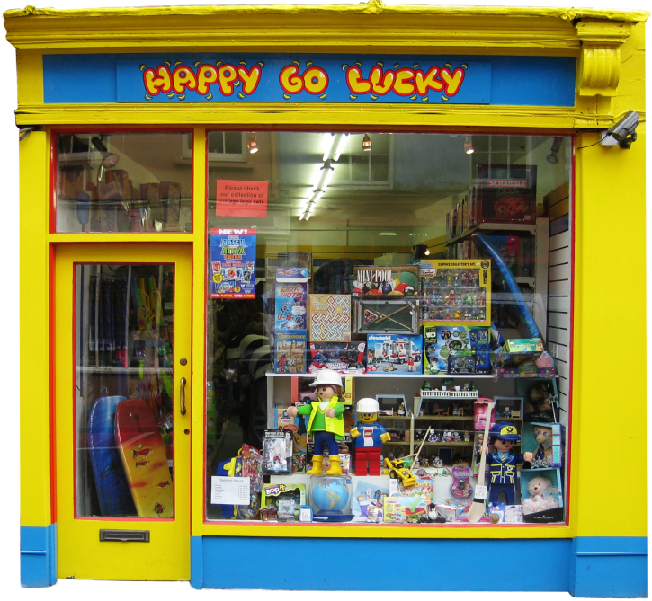
For Today
Makefiles
compiling multiple files
Geany
a primitive IDE
Universal Markup Language
Abstract Data Types
C++ Classes

Slide 5
Marker Slide
Any General Questions
Next up
makefiles
geany
ADTs
UML
C++ classes

Slide 6
Multiple File Compiles and Builds
Many programs in this class will have multiple files.
To compile and build multiple files is done from the command prompt (terminal window):
g++ file01.cpp file02.cpp file03.cpp

Slide 7
Class Activity – Using Makefiles
In D2L (Content -> General Info)
Making_Makefiles_Example.pdf
Open that file and follow along with the next few slides
ASIDE:
Command:
dos2unix myfile.txt
may be helpful if copying text
between windows and linux

Slide 8
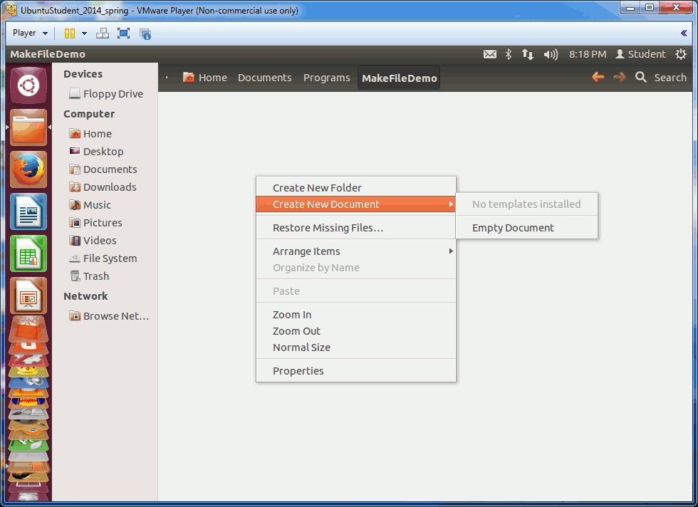
Class Activity Demo – Create Source
Animated GIF
Create the 3 files (use editor of choice)
HelloMain.cpp
HelloFunction.cpp
HelloFunction.h
HelloMain.cpp | HelloFunction.cpp | HelloFunction.h
#include "HelloFunction.h" int main() { HelloFunction(); return 0; } | #include "HelloFunction.h" void HelloFunction() { cout << "Hello there\n"; } | // include standard stuff void HelloFunction();

Slide 9
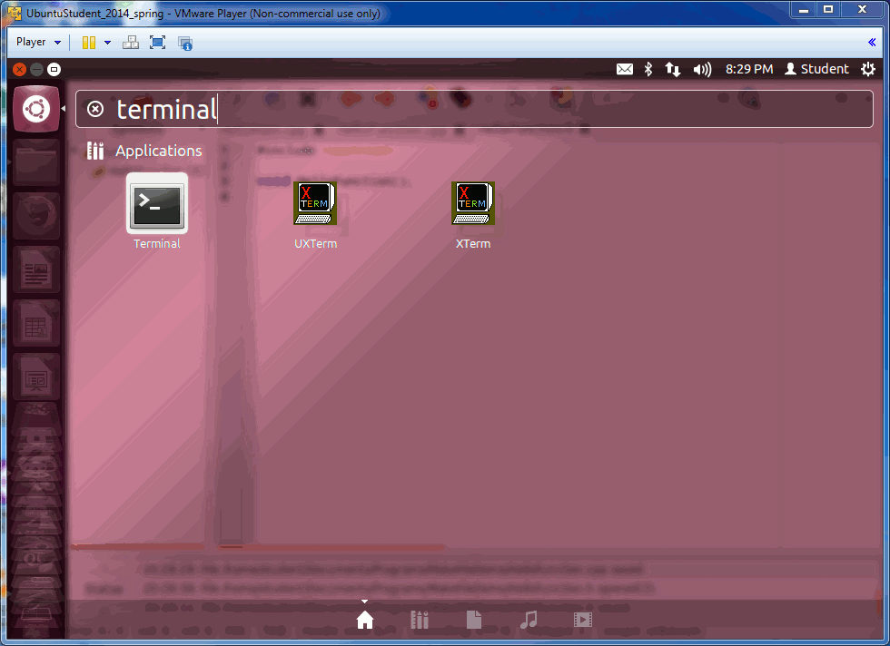
Class Activity Demo: g++ Compile/Build
Compile and build from Terminal Window
g++ -o hello HelloMain.cpp HelloFunction.cpp
Run the resulting executable
./hello
Remove the hello file
rm hello
Animated GIF

Slide 10
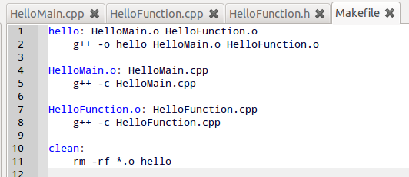
Class Activity Demo – Create makefile
Create a makefile
The lines that start with g++ (and rm) must begin with a TAB
spaces will not work
makefile
hello: HelloMain.o HelloFunction.o g++ -o hello HelloMain.o HelloFunction.o HelloMain.o: HelloMain.cpp g++ -c HelloMain.cpp HelloFunction.o: HelloFunction.cpp g++ -c HelloFunction.cpp clean: rm -rf *.o hello

Slide 11
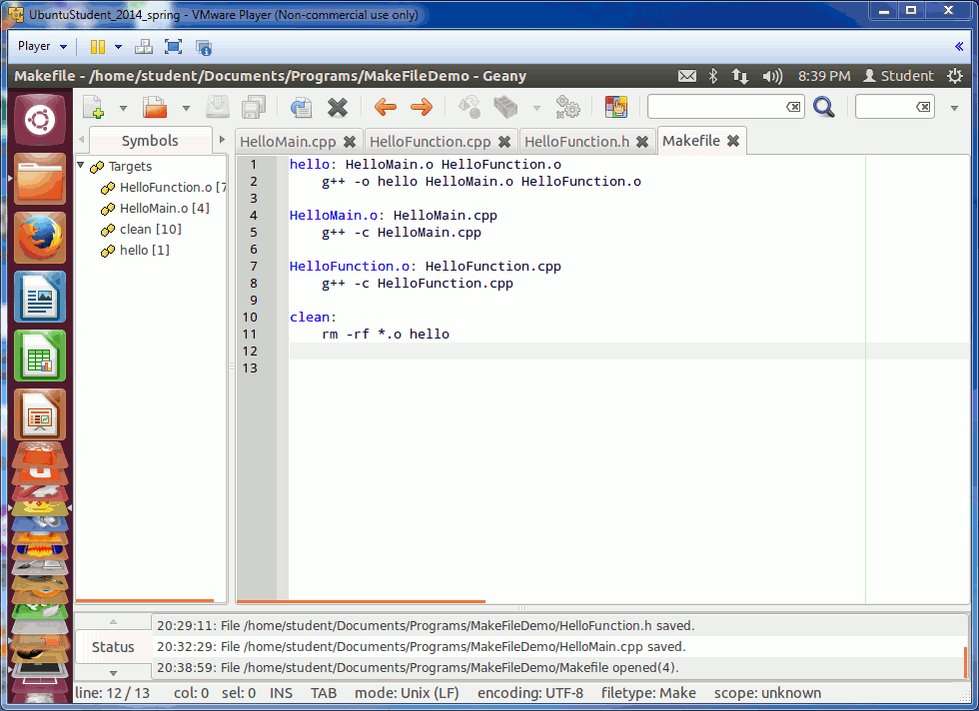
Class Activity Demo – use makefile
Compile and build from Terminal Window
make
Run the resulting executable
./hello
Remove the .o files and hello
make clean
Animated GIF (run the powerpoint and wait a second or two)

Slide 12
Marker Slide
Any questions on
makefiles
Next up
geany
ADTs
UML
C++ classes

Slide 13
Using Geany
Geany is a very primitive IDE
But is better than command line =)
Geany by “default” only compiles and builds a single cpp file
whatever the “active” one is
This demo will show you how to use a makefile with Geany
The makefile must be in the same folder as your source code
The executable specified by the makefile must be the same name as the file that has your main() function in it

Slide 14
Class Activity – Geany Makefiles
You may want to follow along with the next few slides
It will make things easier for you in the future

Slide 15
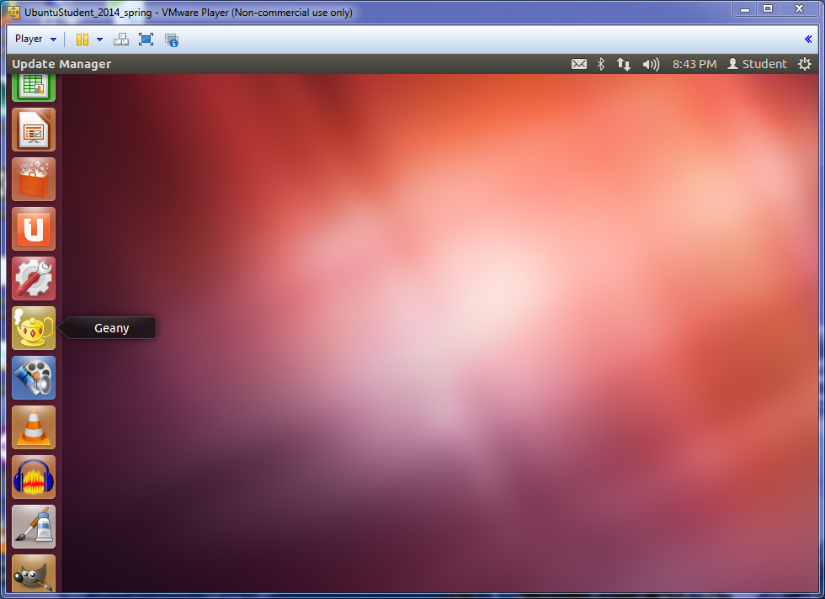
Class Activity Demo – Open Geany

Slide 16
Class Activity Demo – Geany
Open all the files in Geany
HelloMain.cpp HelloFunction.cpp HelloFunction.h
and makefile
Reiterating
to use makefiles with Geany
the executable name in the makefile must be the same as the filename that has main()

Slide 17
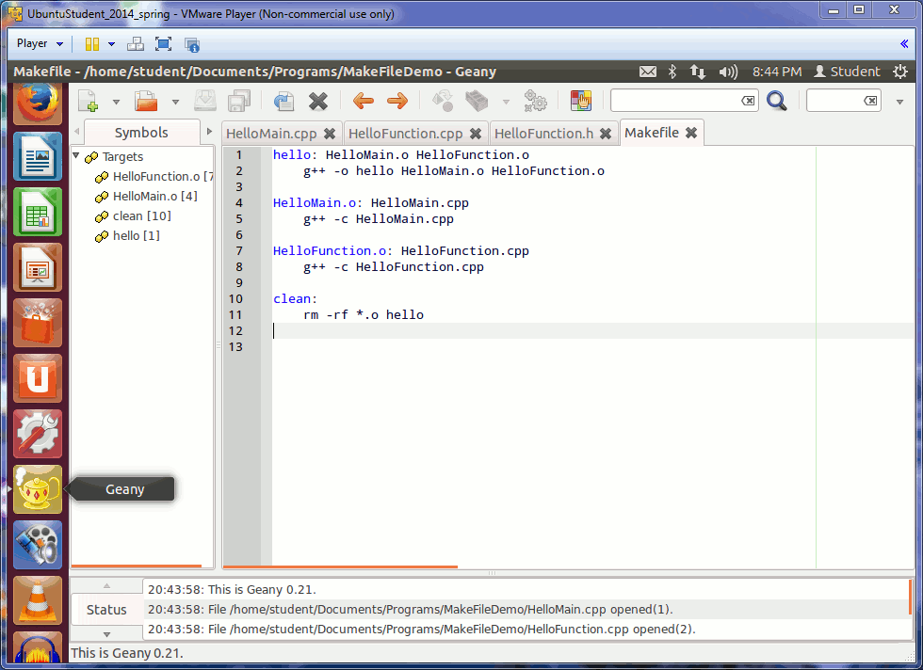
Class Activity Demo – Geany Adapt 1
Change the makefile slightly:
Change the
hello executable
name to be
HelloMain
makefile
hello: HelloMain.o HelloFunction.o g++ -o hello HelloMain.o HelloFunction.o HelloMain.o: HelloMain.cpp g++ -c HelloMain.cpp HelloFunction.o: HelloFunction.cpp g++ -c HelloFunction.cpp clean: rm -rf *.o hello
Animated GIF

Slide 18
Class Activity Demo – Geany Adapt 1
Change the makefile slightly:
Change the
hello executable
name to be
HelloMain
makefile
HelloMain: HelloMain.o HelloFunction.o g++ -o HelloMain HelloMain.o HelloFunction.o HelloMain.o: HelloMain.cpp g++ -c HelloMain.cpp HelloFunction.o: HelloFunction.cpp g++ -c HelloFunction.cpp clean: rm -rf *.o HelloMain
Animated GIF

Slide 19
Class Activity Demo – Geany
Now, if you open the file with the main() function in it
In this case HelloMain.cpp
You can select the dropdown “make all” option in Geany
to compile and build all the files
as described in the makefile
[ shown on next slides ]

Slide 20
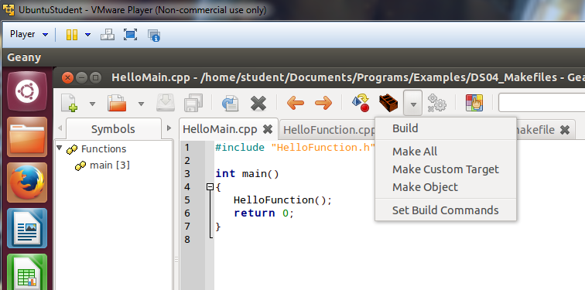
Class Activity Demo – Geany Make All
Press this down
arrow button
to get the drop
down menu
Be sure the file with your main()
function is the
“current tab”

Slide 21
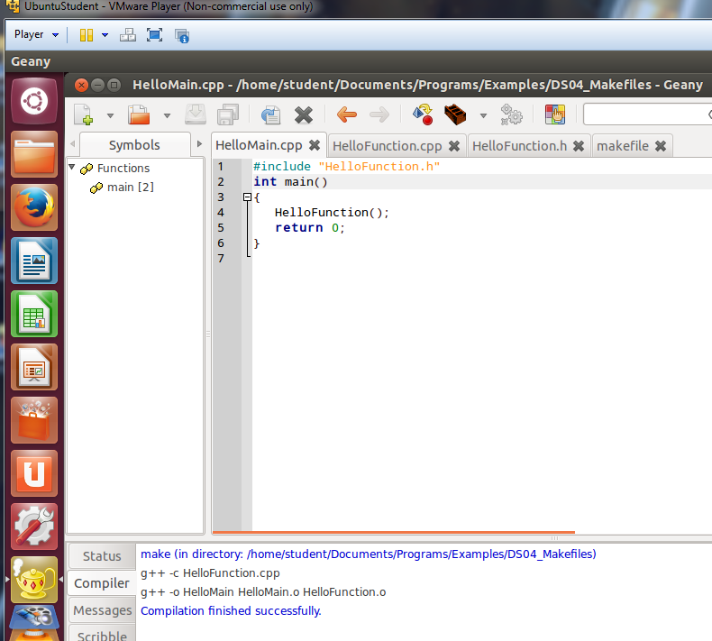
Class Activity Demo – Geany Make Success

Slide 22
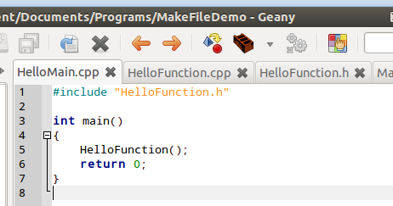
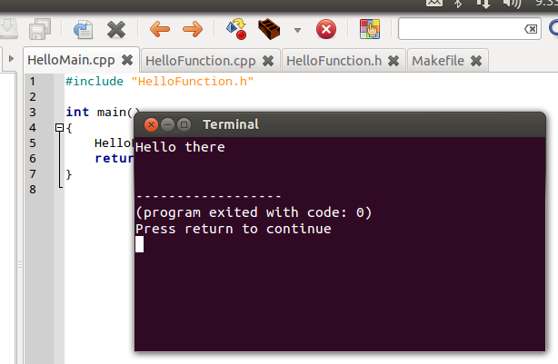
Class Activity Demo – Geany Run
Run the program
Press the ‘gray’ gears button
or on the keyboard press F5
Be sure the .cpp file with main() is still the “current tab” in Geany
In this case HelloMain.cpp

Slide 23
Class Activity Demo – Geany Make Clean
After running the program
If you make any changes to your files you will need to do a
make clean
before the next make all

Slide 24
Class Activity Demo – Mantra
Make Clean
then
Make All
Repeat

Slide 25
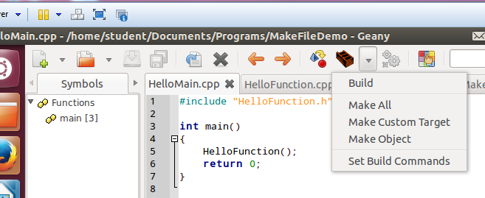
Class Activity Demo – Make Clean Geany
Select: Make Custom Target
Press this down
arrow button
to get the drop
down menu

Slide 26
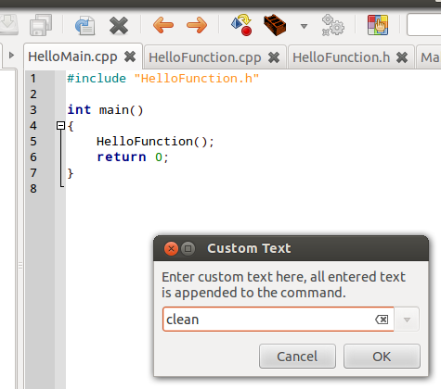
Class Activity Demo – Make Clean Geany
Type: clean
and press OK

Slide 27
Class Activity Demo – Make Clean Geany
Near the bottom of the screen you should see a message like this (if it succeeds)

Slide 28
Marker Slide
Any questions on
makefiles
geany
Next up
ADTs
UML
C++ classes

Slide 29
First Recall using C++ classes
Up to now we have been using C++ classes
Just by knowing their interface
Allowing us to use a class without worrying about anything else
For example
std::vector
Interface includes:
the data elements
the member functions: size(), push_back(), insert(), empty() etc.
We use them but don’t need to know how they work
However, C++ classes are divided into 2 parts
Interface
and Implementation

Slide 30
Abstract Data Types(ADTs)
An ADT describes a public interface
Where the interface includes
a public set of data
and a public set of functions (aka methods, or operations)

Slide 31
Abstract Data Types(ADTs) and C++
An ADT describes a public interface
Where the interface includes
a public set of data
and a public set of functions (aka methods, or operations)
In C++ this interface is the public part of a class.
Most often declared in the header file for the class (.h file)

Slide 32
ADT Implementation and C++
The implementation of an ADT
answers the HOW question
STL has implemented many ADTs
It is just one way to implement them
In C++ this implementation is in the definition of a class’s functions
Most often defined in a class’s .cpp file.

Slide 33
Class Activity – Trucks and Cars
In groups of 2 to 5 people
In 5 minutes or less
On the back of a piece of paper write all the names of the people in your group.
On the front, Draw a vertical line to divide the front side of the paper into two halves.
Label the left half: Pickup Truck
Label the right half: Car
Decide as a group the abstract description of each and write that description in the appropriate area
Make a list of attributes for each

Slide 34
Survey the Results
Check with each group and write the results on the board
This will be returned to later
Pick-Up Truck
Car

Slide 35
Marker Slide
Any questions on
makefiles
geany
ADTs
Next up
UML
C++ classes

Slide 36
Going from ADTs to code
Going from an abstract idea to actual C++ code requires
planning
and often stepwise refinement

Slide 37
Planning Tools
Programmers often use pseudo-code and flow charts to plan out code
good for many things
but still difficult to read for some people
and not that useful for documenting
To offset this a lot of planning is now done using Universal Modeling Language (UML) documents
a nice blend of “business” type thinking and methods with “engineering/science” type thinking and methods
good for documenting for a wider range of audiences

Slide 38
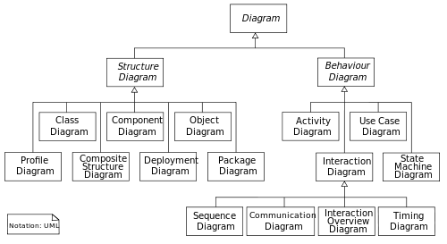
Abstract Representation To C++
A common way to convey abstract data types to be implemented into a programming language is through the use of the Universal Modeling Language (UML)
UML is standardized as accepted by the International Organization for Standardization (ISO)
http://www.omg.org/spec/UML/
There are currently two categories of UML diagrams each with seven diagram types (UML 2.2)

Slide 39
UML Class Diagram
We will mostly focus on class diagrams
These show a system’s structure by illustrating its classes, the class attributes, and relationship to other classes.

Slide 40
SimplePerson UML
Visibility Indicators
+ Public
- Private
# Protected
/ Derived (can be combined with one of the others)
_ Static
minus sign means these two are PRIVATE
SimplePerson
- m_nameStr: string - m_idStr: string
+ SimplePerson(const string& nameStr, const string& idStr); + ~SimplePerson() + print() : void + getName() : string
Friend functions + bool operator==(const SimplePerson& lhs, const SimplePerson& rhs)
plus sign means these are PUBLIC
plus sign means this is PUBLIC too

Slide 41
Class Activity – Similarities and Hierarchy
On the board move stuff around
Vehicle
Pick-Up Truck
Car
Van

Slide 42
UML Hierarchy
UML allows for one class to be a generalization of another
This is called an “is a” relationship
For example, in the below a Student “is a” SimplePerson
SimplePerson
- m_nameStr: string - m_idStr string
+ SimplePerson(const string& nameStr, const string& idStr); + ~SimplePerson() + print() : void + getName() : string
Friend functions + bool operator==(const SimplePerson& lhs, const SimplePerson& rhs)
Aside:
This does not mean students are simple
Student
- m_major: string - m_gradYear: int
+ Student(const string& sname, const string& sid, const string& smajor, int year); + ~Student() + print(): void + changeMajor(string newMajor) :void

Slide 43
Marker Slide
Any questions on
makefiles
geany
ADTs
UML
Next up
C++ classes
Notes:
Expect to be around 60 minutes when getting to this slide

Slide 44
Object-Oriented Programming (OOP)
In Object-Oriented Programming
You define different types of objects with relationships to each other that allow the objects to interact
In C++, you can
Create new types by defining classes
Declare class data members and data functions
Instantiate objects from classes
Set member access levels
Declare static data members and member functions

Slide 45
Previous Experience
You all have seen OOP before
Java is an object-oriented language
So the theory is old-hat to you
And we can move right into examples =)

Slide 46
Class Activity – Simple Critter Class
Download EX020_SimpleCritter.cpp from D2L
Rename the file SimpleCritter.cpp
This really should be three files (plus a makefile)
SimpleCritter.h header for class declaration
SimpleCritter.cpp for class definition
SimpleCritterTest.cpp for the main() function
But to keep things simple
it’s all in one file… for now
Take 5 minutes to look over how the code works
If you get done early move on to the next couple slides

Slide 47
Examination of SimpleCritter
//Simple Critter
//Demonstrates creating a new type
#include <iostream>
using namespace std;
// class definition –– defines a new type, Critter
class Critter
{
public:
int m_Hunger; // data member
void Greet(); // member function prototype
};
// member function definition
void Critter::Greet()
{
cout << "Hi. I’m a critter. My hunger level is "
<< m_Hunger << ".\n";
}
int main()
{
Critter crit1;
Critter crit2;
crit1.m_Hunger = 9;
cout << "crit1’s hunger level is "
<< crit1.m_Hunger << ".\n";
crit2.m_Hunger = 3;
cout << "crit2’s hunger level is "
<< crit2.m_Hunger << ".\n\n";
crit1.Greet();
crit2.Greet();
return 0;
}

Slide 48
Marker Slide
Any questions on
makefiles
geany
ADTs
UML
C++ (basic)
Next up
C++ classes
Constructors

Slide 49
C++ class Constructors
Every class has a constructor function
This function is called when a variable of the class type is instantiated
i.e. on the line of code the variable is declared
Example: myClass varName;
Class constructors typically are used to
allocate any dynamic memory needed by the class member variables
and provide initial values to class member variables

Slide 50
Class Activity – Constructor Critter Class
Download EX021_ConstructorCritter.cpp from D2L
Rename the file ConstructorCritter.cpp
This really should be three files (plus a makefile)
ConstructorCritter.h (header) for class declaration
ConstructorCritter.cpp for class definition
ConstructorCritterTest.cpp for the main() function
But to keep things simple
it’s all in one file… for now
Take 5 minutes to look over how the code works
If you get done early move on to the next couple slides

Slide 51
Examination of ConstructorCritter
//Constructor Critter
//Demonstrates constructors
#include <iostream>
using namespace std;
class Critter
{
public:
int m_Hunger;
Critter(int hunger = 0); // constructor prototype
void Greet();
};
Critter::Critter(int hunger) // constructor definition
{
cout << "A new critter has been born!" << endl;
m_Hunger = hunger;
}
void Critter::Greet()
{
cout << "Hi. I’m a critter. My hunger level is " << m_Hunger << ".\n\n";
}
The constructor
Here the prototype also
provides a default value of 0
The name of the constructor
function is the name of the class
It is implicitly called when variables of the
class type are instantiated (declaration line)
The constructor definition
sets the initial value of the
member variable
int main()
{
// init the hunger level to 7
Critter crit(7);
crit.Greet();
return 0;
}

Slide 52
Marker Slide
Any questions on
makefiles
geany
ADTs
UML
C++ (basic, constructors)
Next up
C++ classes
Access Levels: private and public
Getters and Setters

Slide 53
Class Access Levels
Member data variables and member functions can be made
public
Everyone can play with them
or private
Only member functions or friends of the class can play with them
or protected
we leave that for another time (or course)
Class variables default to being private

Slide 54
Why use private?
Keeping your variables private
keeps your data safe from “outsiders”
And allows you to control what outsiders can or can’t do with your data
If you want outsiders to alter or even see your private data members you need to create
Accessor functions: “getters” and “setters”
Public functions typically define the interface to your class
EX: To match the interface description of an ADT
Private functions allow you to do things “behind-the-scenes”

Slide 55
Private Critter
There is example code that illustrates
the use of private data
and creation of getters and setters
EX022_PrivateCritter.cpp
Exploration of that class is left to the student
We need to get a little farther along in details
Investigate
on your own

Slide 56
Marker Slide
Any questions on
makefiles
geany
ADTs
UML
C++ (Basic Concept, Constructors, Access Levels, Getters and Setters)
Next up
C++ classes
static data members

Slide 57
Static Member Data
C++ allows member variables to be declared as static
static int s_numCritters; // “s_” implies var is static by naming convention
A static data member is a single data member that exists for the entire class
These must be initialized outside the class
Typically immediately after the class declaration in the header file
int Critter::s_numCritters = 0;

Slide 58
Accessing static members
You can access static data members anywhere in your program (caveat of public too)
Example in main() you could say:
cout << Critter::s_numCritters << endl;
In functions of the class Critters of course you do not need the “area code” Critters::
cout << s_numCritters << endl
would work just fine in the constructor Critters::Critters

Slide 59
Static Member Functions
You can also create static member functions
Left for the student to explore
Likewise not much more time will be explicitly spent on static data members
An example exists on D2L
EX23_StaticCritter.cpp
Which is recommended to be investigated on the student’s own time
Investigate
on your own

Slide 60
Marker Slide
Any questions on
makefiles
geany
ADTs
UML
C++ (Basic Concept, Constructors, Access Levels, Getters and Setters, static members)
Next up
C++ classes
Putting it all together

Slide 61
Applying All That
There are 2 activities that follow
The first is a graded in-class activity
The second is yet one more “on the student’s own time”
These are followed by just a little more on C++ Hierarchy and Inheritance

Slide 62
Graded Class Activity – class SimplePerson
The next few slides illustrate how to implement a SimplePerson class based on a UML diagram.
Use them to create a program to implement and test a SimplePerson class
For the class you will need 2 files
An interface header file: SimplePerson.h
An implementation file: SimplePerson.cpp
You will also need a file for your main function
SPtester.cpp
#include “SimplePerson.h” (and probably iostream)
Declare a variable of type SimplePerson
Call some of the member functions
There is likely starter code on D2L – go look
Graded
Must Turn
Something In
Notes:
circa 100 minutes here

Slide 63
SimplePerson C++ Interface
This looks important
You should ask
about it
Example: C++ Header File SimplePerson.h
SimplePerson
- m_nameStr: string - m_idStr: string
+ SimplePerson(const string& nameStr, const string& idStr); + ~SimplePerson() + print() : void + getName() : string
Friend functions + bool operator==(const SimplePerson& lhs, const SimplePerson& rhs)
#pragma once
#include <iostream>
#include <string>
using namespace std;
class SimplePerson
{
public:
SimplePerson(const string& nameStr, const string& idStr);
~SimplePerson();
void print();
string getName();
friend bool operator==(const SimplePerson& lhs, const SimplePerson& rhs);
private:
string m_nameStr;
string m_idStr;
};

Slide 64
SimplePerson C++ Interface
Example: C++ Header File SimplePerson.h
SimplePerson
- m_nameStr: string - m_idStr: string
+ SimplePerson(const string& nameStr, const string& idStr); + ~SimplePerson() + print() : void + getName() : string
Friend functions + bool operator==(const SimplePerson& lhs, const SimplePerson& rhs)
#pragma once
#include <iostream>
#include <string>
using namespace std;
class SimplePerson
{
public:
SimplePerson(const string& nameStr, const string& idStr);
~SimplePerson();
void print();
string getName();
friend bool operator==(const SimplePerson& lhs, const SimplePerson& rhs);
private:
string m_nameStr;
string m_idStr;
};
friend?
What does friend mean?
[see next slide]

Slide 65
SimplePerson Implementation
Example: C++ Implementation File – SimplePerson.cpp
#include "SimplePerson.h"
using namespace std;
SimplePerson::SimplePerson(const string& nameStr, const string& idStr)
{
m_nameStr = nameStr;
m_idStr = idStr;
}
SimplePerson::~SimplePerson()
{
cout<< "SimplePerson destructor is called" <<endl;
}
void SimplePerson::print()
{
cout << "Name: " << m_nameStr
cout << ", id: " << m_idStr << endl;
}
string SimplePerson::getName()
{
return m_nameStr;
}
operator==
is a global friend function
Needed if you want to check
if (person1 == person2)
bool operator==(const SimplePerson& lhs,
const SimplePerson& rhs)
{
bool retVal = false;
if ((lhs.m_nameStr == rhs.m_nameStr)
&& (lhs.m_idStr == rhs.m_idStr))
{
retVal = true;
}
return retVal;
}

Slide 66
End Class Activity: Simple Person
Next a quick introduction of another C++ class inside a game

Slide 67
A Simple Critter Game
Let’s design a simple game
The Critter Caretaker game puts the player in charge of his/her own electronic pet.
The player must keep the critter happy by feeding or playing with it
The player can also listen to the critter to hear how it is feeling

Slide 68
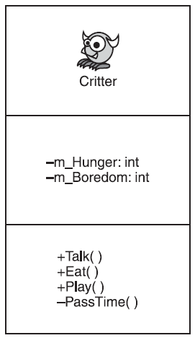
Planning Critter Caretaker
Pseudo-Code planning of “main”
Create a critter
While the player doesn’t want to quit the game
Present a menu of choices to the player
If the player wants to listen to the critter
Make the critter talk
If the player wants to feed the critter
Make the critter eat
If the player wants to play with the critter
Make the critter play
- m_Hunger : int
- m_Boredom : int
+ Talk() : void
+ Eat(int food=4) : void
+ Play(int fun = 4) : void
- GetMood() const : int
- PassTime(int time = 1) : void
UML Visibility Indicators
+ Public
- Private

Slide 69
Critter Caretaker Game
It is suggested the student consider the previous “planning” and attempt to implement a version of the game on their own
However, a functional version is available
EX024_CritterCare.cpp
for inspection by the student
Investigate
on your own

Slide 70
Marker Slide
Any questions on
makefiles
geany
ADTs
UML
C++ classes (lots of stuff)
Next up
C++ classes Inheritance

Slide 71
C++ Hierarchy
The Object-Oriented paradigm, which C++ follows
allows for hierarchy in its classes via inheritance
In general you will develop a base class (or parent class)
such as: SimplePerson
From that base class you will derive a subclass (or child class)
such as: Student
A base class may have multiple subclasses
such as: Student, Instructor, Administrator

Slide 72
C++ Inheritance
Subclasses are said to specialize or extend a base class
Subclasses do NOT need to re-implement functions defined in the base class as the subclass inherits them
Subclasses can re-implement base class functions but should not need to do so
Subclasses should define and declare functions that make it a specialization of the base class

Slide 73
To Some Hands-On Practice
We will talk more on inheritance in later classes
For today we will end with some practice
[next slides]

Slide 74
Class Activity – class Student
Create a C++ class Student derived from SimplePerson
Use the code in the above slides as appropriate
may look on D2L also for some starter code
Be sure to create a main() routine in a file named PersonTest.cpp to test out your new classes
Extra Challenge
Instead of using
g++ PersonTest.cpp SimplePerson.cpp Student.cpp
Create a makefile to compile and build this program
Example on D2L likely (may be in general section or examples)
SimplePerson
- m_nameStr: string - m_idStr string
+ SimplePerson(const string& nameStr, const string& idStr); + ~SimplePerson() + print() : void + getName() : string
Student
- m_major: string - m_gradYear: int
+ Student(const string& sname, const string& sid, const string& smajor, int year); + ~ Student () + print(): void + changeMajor(const string& newMajor): void

Slide 75
Marker Slide
Any Questions on
makefiles
geany
ADTs
UML
C++ classes (general or inheritance)
Any General Questions?
Next Up
Free Play
Notes:
Circa 95 to 100 minutes

Slide 76
Free Play – Things to Work On
Homework 3
Homework 4
Graded – In-Class Activity: Simple Person
In-Class Activity: Student
Example: Critter Caretaker
Student Initiative Work: A01_time24

Slide 77
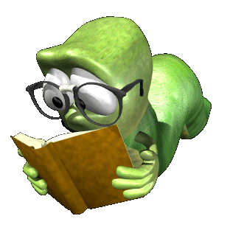
The End
Or is it?

