Slide 1
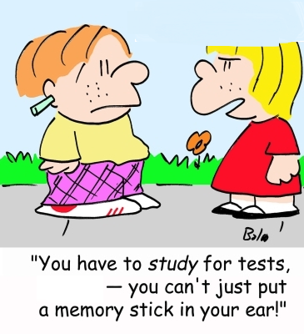
Take the Test
Data Structures and Algorithms
CS 244
Brent M. Dingle, Ph.D.
Department of Mathematics, Statistics, and Computer Science
University of Wisconsin – Stout
Based on the book: Data Structures and Algorithms in C++ (Goodrich, Tamassia, Mount)
Some content derived/taken from: http://www.stroustrup.com/Programming/

Slide 2
Points of Note
You should be taking the test
Not reading this

Slide 3
The End
It says, The End
Good day. =)

Slide 5
Backup Slides – Not Used
The slides that follow may or may not be accurate
They are remnants of thoughts that might have gone into the presentation
Or things that might have been useful to answer potential questions
Or things that came up as questions to be added next semester
In general the student can/should ignore them, unless directed otherwise

Slide 6
Backup Slides follow
Anything after this slide is just for backup to address possible things mentioned in class
or was once part of the presentation
or was an idea to be made part of the presentation
The backup slides may have ERRORs
Unless otherwise directed
Students need NOT worry about the slides after this one

Slide 8
End Back up Slides
The presentation ended well before this slide.
It is best to go through this presentation starting at the the first slide
Information on backup slides is likely not needed and may have errors

