Slide 1
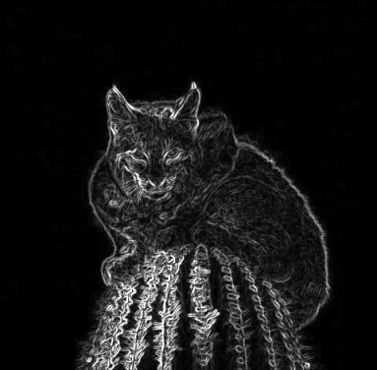
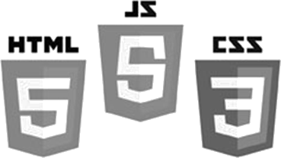
Image Processing
HTML5 – Canvas
Using Simple Image Filters
Brent M. Dingle, Ph.D. 2015
Game Design and Development Program
Mathematics, Statistics and Computer Science
University of Wisconsin - Stout

Slide 2
Lecture Objectives
Provide Examples
Basic HTML5 canvas
Pixel Manipulation using Image Filters
Bonus
Loading an image via drag-and-drop

Slide 3
What this is Not
To complete your projects
You must learn more about HTML5 and JavaScript than what is about to be shown
This is an “on-your-own” activity
Instructor can help, but you must try on your own
A prereq to this course is CS 244
So you have programmed before
This stuff is “easy” compared to that =)
Likewise on the math topics
In Sum: The following is just a place to start
More examples will follow throughout the course

Slide 4
Previously
Digital Image Processing (DIP)
Is computer manipulation of pictures, or images, that have been converted into numeric form
A Digital Image
Is a picture or image converted to numeric form
In grey-scale the image can be thought of as
2D function f(x, y) or a matrix
x, y, and f(x, y) are discrete and finite
Image size = (x_{max}) by (y_{max}), e.g. 1024 x 768
Pixel Intensity Value = f(x,y) ∈ [0, 255]
Code to manipulate pixels directly already presented
Using HTML5 and JavaScript

Slide 5
Recall: Pixel Array
JavaScript arrays work like C/C++/Java
Use the standard accessors to index into the array
EX:
mya[0] is the first element in the array named mya
mya[k-1] is the k-th element in the array named mya
Pixels in the array are in row-major order
with values of 0 to 255
where each four-integer group represents the four color channels: Red-Green-Blue-Alpha or RGBA
illustration next slide

Slide 6
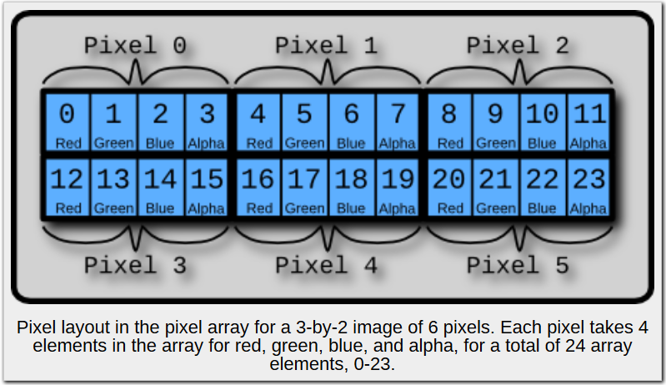
Pixel Order
image from: http://beej.us/blog/data/html5s-canvas-2-pixel/

Slide 7
Today: Jump Ahead
Image Filtering (and Edge detection) will be covered later
In the theoretical
It is used here as an example of using an Image Filter
Example code for doing this is more useful sooner than later

Slide 8
Kernels
A kernel, convolution matrix, or mask
is a ‘small’ matrix useful for image manipulation
edge-detection, blurring, sharpening, embossing…
This is accomplished by means of convolution between a kernel and an image
The size of the matrix reflects the size of the neighborhood by which a given pixel will be transformed

Slide 9
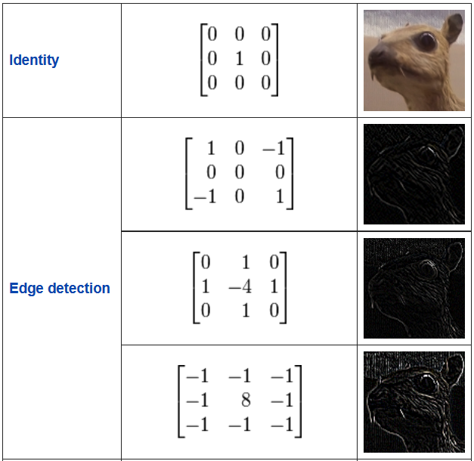
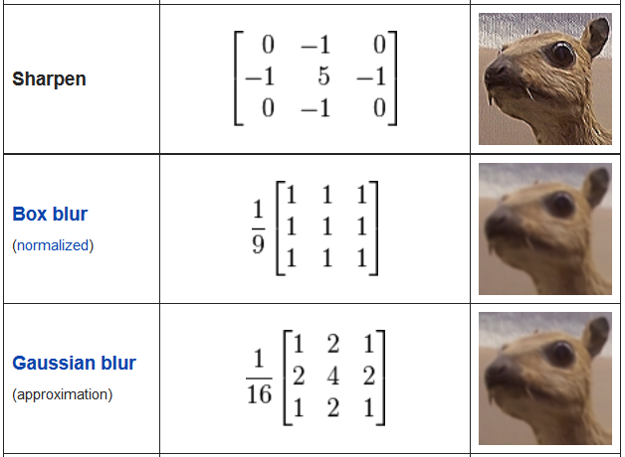
Examples
public domain images from Wikipedia

Slide 10
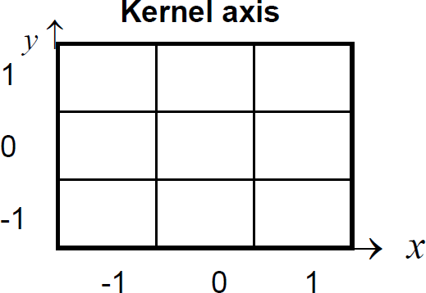
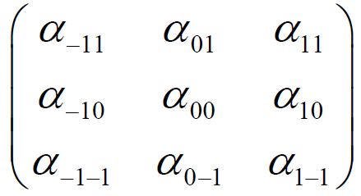
3x3 Convolution Math
3 by 3 kernel with weights α_{ij}
The convolution of an I_old image by the kernel is denoted:
Aside: Normalization helps keep image values in the desired range
-- caution must be used in how and when this is done in program code to avoid undesired data loss, truncation, rounding, scaling…

Slide 11
Convolution: Pseudo-Code
Pseudocode for the convolution of an image f(x,y) with a kernel k(x, y) to produce a new image g(x, y)
for y = 0 to imageHeight
for x = 0 to imageWidth
sum = 0
for i = -h to h
for j = -w to w
sum = sum + k(j, i) * f(x – j, y – i)
end for j
end for i
g(x, y) = sum
end for x
end for y
Assume:
kernel width is 2w+1
kernel height is 2h+1
Aside:
Be careful about non-symmetric kernels
Align their (-w, -h) to be same corner
as the image (0, 0)
i.e. upper left corner or lower left ?

Slide 12
Convolution Border Issues
Some pixels do not have enough neighbors
typically: corner pixels and edge pixels
Addressing these issues
Extend the image limits with zeros
Extend image limits with replication (of problem pixel value)
Generate specific filter for border cases

Slide 13
General Questions?
Code example next

Slide 14
filterImage.html
<!DOCTYPE html>
<html lang="en">
<head>
<meta content="text/html; charset=utf-8" http-equiv="content-type">
<title>Example: Filter Loaded Image Data</title>
<script src="filter.js" type="text/javascript"></script>
<script src="filterImage.js" type="text/javascript"></script>
</head>
<body>
<div>
<table>
<tr>
<canvas id="sourceCanvas" style="width:180px; height:90px; border:1px solid #aaaaaa; display:none">
Your browser does not support the HTML5 canvas tag.
</canvas>
</tr>
<tr>
<canvas id="outputCanvas" style="width:180px; height:90px; border:1px solid #aaaaaa;display:none">
</canvas>
</tr>
</table></div>
</body>
</html>
Using TWO script files
And TWO canvas elements
one to show input
the other for output

Slide 15
Questions
Questions on
filterImage HTML file ?
Next is filter image javaScript file

Slide 16
filterImage.js
var theProgram =
{
// ------------------------------------------------------------------------
// Pseudo-constants
// ------------------------------------------------------------------------
SOURCE_IMG_CANVAS_ID: "sourceCanvas", // canvas id used in html
OUTPUT_IMG_CANVAS_ID: "outputCanvas", // canvas id used in html
// ------------------------------------------------------------------------
// Variables
// ------------------------------------------------------------------------
width: 400, // canvas width... likely will be reset
height: 400, // canvas height... likely will be reset
xOffset: 5,
yOffset: 5,
dropArea: null,
srcData: null,
destCanvas: null,
destCTX: null,
// ------------------------------------------------------------------------
// Functions
“global” variables for the program

Slide 17
filterImage.js
Main: function()
{
// Setup the listeners
this.dropArea = document.getElementById('theDropArea');
this.dropArea.addEventListener('dragover', this.onDragOver, false);
this.dropArea.addEventListener('drop', this.onDropFileSelect, false);
// Get handle on the OUTPUT destCanvas
theProgram.destCanvas
= document.getElementById(theProgram.OUTPUT_IMG_CANVAS_ID);
theProgram.destCTX = theProgram.destCanvas.getContext('2d');
// initialize the filter
theFilter.Init();
},
Event handlers
to allow user to drag an input
image file onto the canvas

Slide 18
filterImage.js
Main: function()
{
// Setup the listeners
this.dropArea = document.getElementById('theDropArea');
this.dropArea.addEventListener('dragover', this.onDragOver, false);
this.dropArea.addEventListener('drop', this.onDropFileSelect, false);
// Get handle on the OUTPUT destCanvas
theProgram.destCanvas
= document.getElementById(theProgram.OUTPUT_IMG_CANVAS_ID);
theProgram.destCTX = theProgram.destCanvas.getContext('2d');
// initialize the filter
theFilter.Init();
},
// ------------------------------------------------------------------------
// ------------------------------------------------------------------------
onDragOver: function(evt)
{
evt.stopPropagation();
evt.preventDefault();
evt.dataTransfer.dropEffect = 'copy'; // Explicitly make this is a copy
},
onDragOver
Give control of response solely
to our program
Make drop event a ‘copy’ data

Slide 19
filterImage.js
onDragOver: function(evt)
{
evt.stopPropagation();
evt.preventDefault();
evt.dataTransfer.dropEffect = 'copy'; // Explicitly make this is a copy
},
// ------------------------------------------------------------------------
onDropFileSelect: function (evt)
{
evt.stopPropagation();
evt.preventDefault();
var files = evt.dataTransfer.files; // files that were dragged
// If the "first" file is not an image, do nothing
var curFile = files[0];
// Only process image file
if ( curFile.type.match('image.*') )
{
var img = new Image;
img.onload = function()
{
//theProgram.dropArea.style.display = "none"; unrem to allow only 1 drop
var canvas = document.getElementById(theProgram.SOURCE_IMG_CANVAS_ID);
var ctx = canvas.getContext('2d');
canvas.style.display = "block";
canvas.width = img.width;
canvas.height = img.height;
canvas.style.width = canvas.width + "px" ;
canvas.style.height = canvas.height + "px";
ctx.drawImage(img, 0, 0);
onDrop
Again give full control to our program

Slide 20
filterImage.js
onDragOver: function(evt)
{
evt.stopPropagation();
evt.preventDefault();
evt.dataTransfer.dropEffect = 'copy'; // Explicitly make this is a copy
},
// ------------------------------------------------------------------------
onDropFileSelect: function (evt)
{
evt.stopPropagation();
evt.preventDefault();
var files = evt.dataTransfer.files; // files that were dragged
// If the "first" file is not an image, do nothing
var curFile = files[0];
// Only process image file
if ( curFile.type.match('image.*') )
{
var img = new Image;
img.onload = function()
{
//theProgram.dropArea.style.display = "none"; unrem to allow only 1 drop
var canvas = document.getElementById(theProgram.SOURCE_IMG_CANVAS_ID);
var ctx = canvas.getContext('2d');
canvas.style.display = "block";
canvas.width = img.width;
canvas.height = img.height;
canvas.style.width = canvas.width + "px" ;
canvas.style.height = canvas.height + "px";
ctx.drawImage(img, 0, 0);
Get the list of files
that were dropped on the canvas

Slide 21
filterImage.js
onDragOver: function(evt)
{
evt.stopPropagation();
evt.preventDefault();
evt.dataTransfer.dropEffect = 'copy'; // Explicitly make this is a copy
},
// ------------------------------------------------------------------------
onDropFileSelect: function (evt)
{
evt.stopPropagation();
evt.preventDefault();
var files = evt.dataTransfer.files; // files that were dragged
// If the "first" file is not an image, do nothing
var curFile = files[0];
// Only process image file
if ( curFile.type.match('image.*') )
{
var img = new Image;
img.onload = function()
{
//theProgram.dropArea.style.display = "none"; unrem to allow only 1 drop
var canvas = document.getElementById(theProgram.SOURCE_IMG_CANVAS_ID);
var ctx = canvas.getContext('2d');
canvas.style.display = "block";
canvas.width = img.width;
canvas.height = img.height;
canvas.style.width = canvas.width + "px" ;
canvas.style.height = canvas.height + "px";
ctx.drawImage(img, 0, 0);
Only look at first file in list → item index ZERO
If that file type is not an image file
Then we do nothing (drop results in nothing)

Slide 22
filterImage.js
onDragOver: function(evt)
{
evt.stopPropagation();
evt.preventDefault();
evt.dataTransfer.dropEffect = 'copy'; // Explicitly make this is a copy
},
// ------------------------------------------------------------------------
onDropFileSelect: function (evt)
{
evt.stopPropagation();
evt.preventDefault();
var files = evt.dataTransfer.files; // files that were dragged
// If the "first" file is not an image, do nothing
var curFile = files[0];
// Only process image file
if ( curFile.type.match('image.*') )
{
var img = new Image;
img.onload = function()
{
//theProgram.dropArea.style.display = "none"; unrem to allow only 1 drop
var canvas = document.getElementById(theProgram.SOURCE_IMG_CANVAS_ID);
var ctx = canvas.getContext('2d');
canvas.style.display = "block";
canvas.width = img.width;
canvas.height = img.height;
canvas.style.width = canvas.width + "px" ;
canvas.style.height = canvas.height + "px";
ctx.drawImage(img, 0, 0);
Allocate memory for a new image

Slide 23
filterImage.js
onDragOver: function(evt)
{
evt.stopPropagation();
evt.preventDefault();
evt.dataTransfer.dropEffect = 'copy'; // Explicitly make this is a copy
},
// ------------------------------------------------------------------------
onDropFileSelect: function (evt)
{
evt.stopPropagation();
evt.preventDefault();
var files = evt.dataTransfer.files; // files that were dragged
// If the "first" file is not an image, do nothing
var curFile = files[0];
// Only process image file
if ( curFile.type.match('image.*') )
{
var img = new Image;
img.onload = function()
{
//theProgram.dropArea.style.display = "none"; unrem to allow only 1 drop
var canvas = document.getElementById(theProgram.SOURCE_IMG_CANVAS_ID);
var ctx = canvas.getContext('2d');
canvas.style.display = "block";
canvas.width = img.width;
canvas.height = img.height;
canvas.style.width = canvas.width + "px" ;
canvas.style.height = canvas.height + "px";
ctx.drawImage(img, 0, 0);
Set up a load function for the new image
BEFORE we assign a file source name
to the image

Slide 24
filterImage.js
// If the "first" file is not an image, do nothing
var curFile = files[0];
// Only process image file
if ( curFile.type.match('image.*') )
{
var img = new Image;
img.onload = function()
{
//theProgram.dropArea.style.display = "none"; unrem to allow only 1 drop
var canvas = document.getElementById(theProgram.SOURCE_IMG_CANVAS_ID);
var ctx = canvas.getContext('2d');
canvas.style.display = "block";
canvas.width = img.width;
canvas.height = img.height;
canvas.style.width = canvas.width + "px" ;
canvas.style.height = canvas.height + "px";
ctx.drawImage(img, 0, 0);
// Set the source data BEFORE applying any filters!
theProgram.srcData = ctx.getImageData(0, 0, img.width, img.height);
theProgram.applyConvSobel();
URL.revokeObjectURL(img.src); // clear up memory...
}
img.src = URL.createObjectURL(curFile);
}
// else current file type is NOT image --> so do nothing
},
Get canvas and context for the SOURCE image

Slide 25
filterImage.js
// If the "first" file is not an image, do nothing
var curFile = files[0];
// Only process image file
if ( curFile.type.match('image.*') )
{
var img = new Image;
img.onload = function()
{
//theProgram.dropArea.style.display = "none"; unrem to allow only 1 drop
var canvas = document.getElementById(theProgram.SOURCE_IMG_CANVAS_ID);
var ctx = canvas.getContext('2d');
canvas.style.display = "block";
canvas.width = img.width;
canvas.height = img.height;
canvas.style.width = canvas.width + "px" ;
canvas.style.height = canvas.height + "px";
ctx.drawImage(img, 0, 0);
// Set the source data BEFORE applying any filters!
theProgram.srcData = ctx.getImageData(0, 0, img.width, img.height);
theProgram.applyConvSobel();
URL.revokeObjectURL(img.src); // clear up memory...
}
img.src = URL.createObjectURL(curFile);
}
// else current file type is NOT image --> so do nothing
},
Set display style to block (make canvas visible)
Size everything correctly

Slide 26
filterImage.js
// If the "first" file is not an image, do nothing
var curFile = files[0];
// Only process image file
if ( curFile.type.match('image.*') )
{
var img = new Image;
img.onload = function()
{
//theProgram.dropArea.style.display = "none"; unrem to allow only 1 drop
var canvas = document.getElementById(theProgram.SOURCE_IMG_CANVAS_ID);
var ctx = canvas.getContext('2d');
canvas.style.display = "block";
canvas.width = img.width;
canvas.height = img.height;
canvas.style.width = canvas.width + "px" ;
canvas.style.height = canvas.height + "px";
ctx.drawImage(img, 0, 0);
// Set the source data BEFORE applying any filters!
theProgram.srcData = ctx.getImageData(0, 0, img.width, img.height);
theProgram.applyConvSobel();
URL.revokeObjectURL(img.src); // clear up memory...
}
img.src = URL.createObjectURL(curFile);
}
// else current file type is NOT image --> so do nothing
},
Draw image
starting at canvas coordinates ( 0, 0 )

Slide 27
filterImage.js
// If the "first" file is not an image, do nothing
var curFile = files[0];
// Only process image file
if ( curFile.type.match('image.*') )
{
var img = new Image;
img.onload = function()
{
//theProgram.dropArea.style.display = "none"; unrem to allow only 1 drop
var canvas = document.getElementById(theProgram.SOURCE_IMG_CANVAS_ID);
var ctx = canvas.getContext('2d');
canvas.style.display = "block";
canvas.width = img.width;
canvas.height = img.height;
canvas.style.width = canvas.width + "px" ;
canvas.style.height = canvas.height + "px";
ctx.drawImage(img, 0, 0);
// Set the source data BEFORE applying any filters!
theProgram.srcData = ctx.getImageData(0, 0, img.width, img.height);
theProgram.applyConvSobel();
URL.revokeObjectURL(img.src); // clear up memory...
}
img.src = URL.createObjectURL(curFile);
}
// else current file type is NOT image --> so do nothing
},
Set the global variable to reference the
source image data (as drawn on canvas)

Slide 28
filterImage.js
// If the "first" file is not an image, do nothing
var curFile = files[0];
// Only process image file
if ( curFile.type.match('image.*') )
{
var img = new Image;
img.onload = function()
{
//theProgram.dropArea.style.display = "none"; unrem to allow only 1 drop
var canvas = document.getElementById(theProgram.SOURCE_IMG_CANVAS_ID);
var ctx = canvas.getContext('2d');
canvas.style.display = "block";
canvas.width = img.width;
canvas.height = img.height;
canvas.style.width = canvas.width + "px" ;
canvas.style.height = canvas.height + "px";
ctx.drawImage(img, 0, 0);
// Set the source data BEFORE applying any filters!
theProgram.srcData = ctx.getImageData(0, 0, img.width, img.height);
theProgram.applyConvSobel();
URL.revokeObjectURL(img.src); // clear up memory...
}
img.src = URL.createObjectURL(curFile);
}
// else current file type is NOT image --> so do nothing
},
Apply the desired filter

Slide 29
filterImage.js
// If the "first" file is not an image, do nothing
var curFile = files[0];
// Only process image file
if ( curFile.type.match('image.*') )
{
var img = new Image;
img.onload = function()
{
//theProgram.dropArea.style.display = "none"; unrem to allow only 1 drop
var canvas = document.getElementById(theProgram.SOURCE_IMG_CANVAS_ID);
var ctx = canvas.getContext('2d');
canvas.style.display = "block";
canvas.width = img.width;
canvas.height = img.height;
canvas.style.width = canvas.width + "px" ;
canvas.style.height = canvas.height + "px";
ctx.drawImage(img, 0, 0);
// Set the source data BEFORE applying any filters!
theProgram.srcData = ctx.getImageData(0, 0, img.width, img.height);
theProgram.applyConvSobel();
URL.revokeObjectURL(img.src); // clear up memory...
}
img.src = URL.createObjectURL(curFile);
}
// else current file type is NOT image --> so do nothing
},
Free up some memory

Slide 30
filterImage.js
// If the "first" file is not an image, do nothing
var curFile = files[0];
// Only process image file
if ( curFile.type.match('image.*') )
{
var img = new Image;
img.onload = function()
{
//theProgram.dropArea.style.display = "none"; unrem to allow only 1 drop
var canvas = document.getElementById(theProgram.SOURCE_IMG_CANVAS_ID);
var ctx = canvas.getContext('2d');
canvas.style.display = "block";
canvas.width = img.width;
canvas.height = img.height;
canvas.style.width = canvas.width + "px" ;
canvas.style.height = canvas.height + "px";
ctx.drawImage(img, 0, 0);
// Set the source data BEFORE applying any filters!
theProgram.srcData = ctx.getImageData(0, 0, img.width, img.height);
theProgram.applyConvSobel();
URL.revokeObjectURL(img.src); // clear up memory...
}
img.src = URL.createObjectURL(curFile);
}
// else current file type is NOT image --> so do nothing
},
the img.onload() function ends

Slide 31
filterImage.js
// If the "first" file is not an image, do nothing
var curFile = files[0];
// Only process image file
if ( curFile.type.match('image.*') )
{
var img = new Image;
img.onload = function()
{
//theProgram.dropArea.style.display = "none"; unrem to allow only 1 drop
var canvas = document.getElementById(theProgram.SOURCE_IMG_CANVAS_ID);
var ctx = canvas.getContext('2d');
canvas.style.display = "block";
canvas.width = img.width;
canvas.height = img.height;
canvas.style.width = canvas.width + "px" ;
canvas.style.height = canvas.height + "px";
ctx.drawImage(img, 0, 0);
// Set the source data BEFORE applying any filters!
theProgram.srcData = ctx.getImageData(0, 0, img.width, img.height);
theProgram.applyConvSobel();
URL.revokeObjectURL(img.src); // clear up memory...
}
img.src = URL.createObjectURL(curFile);
}
// else current file type is NOT image --> so do nothing
},
NOW Set the source file of our image
this will trigger the onload function to be called when the file is completely loaded into the browser
thus the onload function must be defined BEFORE doing this

Slide 32
filterImage.js
// ------------------------------------------------------------------------
applyConvIdentity: function()
{
// below should do 'nothing' apply a filter but change nothing -- debug test
var destData = theFilter.convolute(theProgram.srcData,
[ 0, 0, 0,
0, 1, 0,
0, 0, 0 ]);
theProgram.displayOutput(destData, theProgram.srcData);
},
applyConvIdentity
Apply an identity filter to test the filter class
This filter/matrix should change nothing
The end effect is
pixel[x, y] = pixel[x, y] + 0;
All α_{ij} = 0 except α₀₀ = 1

Slide 33
filterImage.js
// Sobel based edge detection
// Notice this works in steps: greyscale, horizontal, vertical, combine
// ------------------------------------------------------------------------
applyConvSobel: function()
{
var grey = theFilter.greyscale(theProgram.srcData);
var vertical = theFilter.convoluteFloat32(grey,
[-1, -2, -1,
0, 0, 0,
1, 2, 1] );
var horizontal = theFilter.convoluteFloat32(grey,
[-1, 0, 1,
-2, 0, 2,
-1, 0, 1] );
var finalImg = theProgram.destCTX.createImageData(vertical.width, vertical.height);
for (var i=0; i<finalImg.data.length; i+=4)
{
var v = Math.abs(vertical.data[i]);
var h = Math.abs(horizontal.data[i]);
finalImg.data[i] = (v+h)/2;
finalImg.data[i+1] = (v+h)/2;
finalImg.data[i+2] = (v+h)/2;
finalImg.data[i+3] = 255;
}
theProgram.displayOutput(finalImg, theProgram.srcData);
},
Sobel filter implemented as 4 steps

Slide 34
filterImage.js
// Sobel based edge detection
// Notice this works in steps: greyscale, horizontal, vertical, combine
// ------------------------------------------------------------------------
applyConvSobel: function()
{
var grey = theFilter.greyscale(theProgram.srcData);
var vertical = theFilter.convoluteFloat32(grey,
[-1, -2, -1,
0, 0, 0,
1, 2, 1] );
var horizontal = theFilter.convoluteFloat32(grey,
[-1, 0, 1,
-2, 0, 2,
-1, 0, 1] );
var finalImg = theProgram.destCTX.createImageData(vertical.width, vertical.height);
for (var i=0; i<finalImg.data.length; i+=4)
{
var v = Math.abs(vertical.data[i]);
var h = Math.abs(horizontal.data[i]);
finalImg.data[i] = (v+h)/2;
finalImg.data[i+1] = (v+h)/2;
finalImg.data[i+2] = (v+h)/2;
finalImg.data[i+3] = 255;
}
theProgram.displayOutput(finalImg, theProgram.srcData);
},
Step 1
Greyscale the entire image
This is using a greyscale() function
defined in filter.js
We will look at that a little later

Slide 35
filterImage.js
// Sobel based edge detection
// Notice this works in steps: greyscale, horizontal, vertical, combine
// ------------------------------------------------------------------------
applyConvSobel: function()
{
var grey = theFilter.greyscale(theProgram.srcData);
var vertical = theFilter.convoluteFloat32(grey,
[-1, -2, -1,
0, 0, 0,
1, 2, 1] );
var horizontal = theFilter.convoluteFloat32(grey,
[-1, 0, 1,
-2, 0, 2,
-1, 0, 1] );
var finalImg = theProgram.destCTX.createImageData(vertical.width, vertical.height);
for (var i=0; i<finalImg.data.length; i+=4)
{
var v = Math.abs(vertical.data[i]);
var h = Math.abs(horizontal.data[i]);
finalImg.data[i] = (v+h)/2;
finalImg.data[i+1] = (v+h)/2;
finalImg.data[i+2] = (v+h)/2;
finalImg.data[i+3] = 255;
}
theProgram.displayOutput(finalImg, theProgram.srcData);
},
Step 2
Perform a VERTICAL filtering
of the greyscaled image
Store result in variable named vertical

Slide 36
filterImage.js
// Sobel based edge detection
// Notice this works in steps: greyscale, horizontal, vertical, combine
// ------------------------------------------------------------------------
applyConvSobel: function()
{
var grey = theFilter.greyscale(theProgram.srcData);
var vertical = theFilter.convoluteFloat32(grey,
[-1, -2, -1,
0, 0, 0,
1, 2, 1] );
var horizontal = theFilter.convoluteFloat32(grey,
[-1, 0, 1,
-2, 0, 2,
-1, 0, 1] );
var finalImg = theProgram.destCTX.createImageData(vertical.width, vertical.height);
for (var i=0; i<finalImg.data.length; i+=4)
{
var v = Math.abs(vertical.data[i]);
var h = Math.abs(horizontal.data[i]);
finalImg.data[i] = (v+h)/2;
finalImg.data[i+1] = (v+h)/2;
finalImg.data[i+2] = (v+h)/2;
finalImg.data[i+3] = 255;
}
theProgram.displayOutput(finalImg, theProgram.srcData);
},
Step 3
Perform a HORIZONTAL filtering
of the greyscaled image
Store result in variable named horizontal

Slide 37
filterImage.js
// Sobel based edge detection
// Notice this works in steps: greyscale, horizontal, vertical, combine
// ------------------------------------------------------------------------
applyConvSobel: function()
{
var grey = theFilter.greyscale(theProgram.srcData);
var vertical = theFilter.convoluteFloat32(grey,
[-1, -2, -1,
0, 0, 0,
1, 2, 1] );
var horizontal = theFilter.convoluteFloat32(grey,
[-1, 0, 1,
-2, 0, 2,
-1, 0, 1] );
var finalImg = theProgram.destCTX.createImageData(vertical.width, vertical.height);
for (var i=0; i<finalImg.data.length; i+=4)
{
var v = Math.abs(vertical.data[i]);
var h = Math.abs(horizontal.data[i]);
finalImg.data[i] = (v+h)/2;
finalImg.data[i+1] = (v+h)/2;
finalImg.data[i+2] = (v+h)/2;
finalImg.data[i+3] = 255;
}
theProgram.displayOutput(finalImg, theProgram.srcData);
},
Step 4a
Allocate memory for final image

Slide 38
filterImage.js
// Sobel based edge detection
// Notice this works in steps: greyscale, horizontal, vertical, combine
// ------------------------------------------------------------------------
applyConvSobel: function()
{
var grey = theFilter.greyscale(theProgram.srcData);
var vertical = theFilter.convoluteFloat32(grey,
[-1, -2, -1,
0, 0, 0,
1, 2, 1] );
var horizontal = theFilter.convoluteFloat32(grey,
[-1, 0, 1,
-2, 0, 2,
-1, 0, 1] );
var finalImg = theProgram.destCTX.createImageData(vertical.width, vertical.height);
for (var i=0; i<finalImg.data.length; i+=4)
{
var v = Math.abs(vertical.data[i]);
var h = Math.abs(horizontal.data[i]);
finalImg.data[i] = (v+h)/2;
finalImg.data[i+1] = (v+h)/2;
finalImg.data[i+2] = (v+h)/2;
finalImg.data[i+3] = 255;
}
theProgram.displayOutput(finalImg, theProgram.srcData);
},
Step 4b
Set the data values of final image
Red = average of horizontal and vertical filter
Green = average of horizontal and vertical filter
Blue = average of horizontal and vertical filter
Alpha = 255 (opaque)

Slide 39
filterImage.js
// Sobel based edge detection
// Notice this works in steps: greyscale, horizontal, vertical, combine
// ------------------------------------------------------------------------
applyConvSobel: function()
{
var grey = theFilter.greyscale(theProgram.srcData);
var vertical = theFilter.convoluteFloat32(grey,
[-1, -2, -1,
0, 0, 0,
1, 2, 1] );
var horizontal = theFilter.convoluteFloat32(grey,
[-1, 0, 1,
-2, 0, 2,
-1, 0, 1] );
var finalImg = theProgram.destCTX.createImageData(vertical.width, vertical.height);
for (var i=0; i<finalImg.data.length; i+=4)
{
var v = Math.abs(vertical.data[i]);
var h = Math.abs(horizontal.data[i]);
finalImg.data[i] = (v+h)/2;
finalImg.data[i+1] = (v+h)/2;
finalImg.data[i+2] = (v+h)/2;
finalImg.data[i+3] = 255;
}
theProgram.displayOutput(finalImg, theProgram.srcData);
},
Call a function to display the result
to the correct canvas and context

Slide 40
filterImage.js
// ------------------------------------------------------------------------
displayOutput: function(destData)
{
// make things visible and correct size
theProgram.destCanvas.style.display = "block";
theProgram.destCanvas.width = destData.width;
theProgram.destCanvas.height = destData.height;
theProgram.destCanvas.style.width = theProgram.destCanvas.width + "px" ;
theProgram.destCanvas.style.height = theProgram.destCanvas.height + "px";
theProgram.destCTX.putImageData(destData, 0, 0);
},
}; // end theProgram variable
Make the destination canvas visible
with block display

Slide 41
filterImage.js
// ------------------------------------------------------------------------
displayOutput: function(destData)
{
// make things visible and correct size
theProgram.destCanvas.style.display = "block";
theProgram.destCanvas.width = destData.width;
theProgram.destCanvas.height = destData.height;
theProgram.destCanvas.style.width = theProgram.destCanvas.width + "px" ;
theProgram.destCanvas.style.height = theProgram.destCanvas.height + "px";
theProgram.destCTX.putImageData(destData, 0, 0);
},
}; // end theProgram variable
Size the canvas to image size

Slide 42
filterImage.js
// ------------------------------------------------------------------------
displayOutput: function(destData)
{
// make things visible and correct size
theProgram.destCanvas.style.display = "block";
theProgram.destCanvas.width = destData.width;
theProgram.destCanvas.height = destData.height;
theProgram.destCanvas.style.width = theProgram.destCanvas.width + "px" ;
theProgram.destCanvas.style.height = theProgram.destCanvas.height + "px";
theProgram.destCTX.putImageData(destData, 0, 0);
},
}; // end theProgram variable
// ----------------------------------------------------------------------------
window.onload = function()
{
// Initialize and Start the game
theProgram.Main();
};
And run the program
once everything on the page is loaded

Slide 43
Questions
Questions on
filterImage.js javaScript file ?
next is filter.js javaScript file

Slide 44
filter.js
var theFilter =
{
// ------------------------------------------------------------------------
// Pseudo-constants
// ------------------------------------------------------------------------
// ------------------------------------------------------------------------
// Variables
// ------------------------------------------------------------------------
// ------------------------------------------------------------------------
// Functions
// ------------------------------------------------------------------------
// Init
// ------------------------------------------------------------------------
Init: function()
{
// nothing needs to be done here... yet =)
},
Start easy
No class variables
and
No initialization needed

Slide 45
filter.js
var theFilter =
{
::
::
// ------------------------------------------------------------------------
// greyscale
// Assumed:
// pixels are data struct returned by: ctx.getImageData(0, 0, w, h);
// ------------------------------------------------------------------------
greyscale: function(pixels)
{
var d = pixels.data;
for (var i=0; i < d.length; i+=4)
{
var r = d[i];
var g = d[i+1];
var b = d[i+2];
// CIE luminance for the RGB --- fixes appearance for humans
var v = 0.2126*r + 0.7152*g + 0.0722*b;
d[i] = d[i+1] = d[i+2] = v
}
return pixels;
},
Many filters will need to first produce
a greyscale version of the image
So it is included in this class
Note there is an implication in
applying a human eyesight based luminosity adjustment here
Some filters might not want that done…
Also note
variable d
is acting as a name alias for pixels.data
So pixels.data is being altered by this function
HOWEVER
pixels itself is a copy of the data sent as
a parameter to this function
i.e. pixels is a “primitive” JS type, (array-string-ish) or rather pixels is not an “object”
so when returned here it is to modified data,
not the original passed in values

Slide 46
filter.js
// This function is needed for doing things like a Sobel filter
// where intermediate steps do not work if values are clamped
// ------------------------------------------------------------------------
convoluteFloat32: function(pixels, weights, opaque)
{
if (!window.Float32Array)
{
Float32Array = Array;
}
var side = Math.round(Math.sqrt(weights.length));
var halfSide = Math.floor(side/2);
var src = pixels.data;
var sw = pixels.width;
var sh = pixels.height;
var w = sw;
var h = sh;
var output = { width: w,
height: h,
data: new Float32Array(w*h*4)
};
var dst = output.data;
var alphaFac = opaque ? 1 : 0;
This was necessary to support
“older” browsers (for example: IE9)
It might not be needed now

Slide 47
filter.js
// This function is needed for doing things like a Sobel filter
// where intermediate steps do not work if values are clamped
// ------------------------------------------------------------------------
convoluteFloat32: function(pixels, weights, opaque)
{
if (!window.Float32Array)
{
Float32Array = Array;
}
var side = Math.round(Math.sqrt(weights.length));
var halfSide = Math.floor(side/2);
var src = pixels.data;
var sw = pixels.width;
var sh = pixels.height;
var w = sw;
var h = sh;
var output = { width: w,
height: h,
data: new Float32Array(w*h*4)
};
var dst = output.data;
var alphaFac = opaque ? 1 : 0;
Setup size of things
weights.length
is the size of the kernel matrix
e.g. 3x3 matrix has length = 9

Slide 48
filter.js
// This function is needed for doing things like a Sobel filter
// where intermediate steps do not work if values are clamped
// ------------------------------------------------------------------------
convoluteFloat32: function(pixels, weights, opaque)
{
if (!window.Float32Array)
{
Float32Array = Array;
}
var side = Math.round(Math.sqrt(weights.length));
var halfSide = Math.floor(side/2);
var src = pixels.data;
var sw = pixels.width;
var sh = pixels.height;
var w = sw;
var h = sh;
var output = { width: w,
height: h,
data: new Float32Array(w*h*4)
};
var dst = output.data;
var alphaFac = opaque ? 1 : 0;
Allocate memory for the resulting output
output.w = width of resulting image
output.h = height of resulting image
output.data = pixel data… as type float32 (not integer)

Slide 49
filter.js
// This function is needed for doing things like a Sobel filter
// where intermediate steps do not work if values are clamped
// ------------------------------------------------------------------------
convoluteFloat32: function(pixels, weights, opaque)
{
if (!window.Float32Array)
{
Float32Array = Array;
}
var side = Math.round(Math.sqrt(weights.length));
var halfSide = Math.floor(side/2);
var src = pixels.data;
var sw = pixels.width;
var sh = pixels.height;
var w = sw;
var h = sh;
var output = { width: w,
height: h,
data: new Float32Array(w*h*4)
};
var dst = output.data;
var alphaFac = opaque ? 1 : 0;
dst is name alias for output.data → saves some typing

Slide 50
filter.js
// This function is needed for doing things like a Sobel filter
// where intermediate steps do not work if values are clamped
// ------------------------------------------------------------------------
convoluteFloat32: function(pixels, weights, opaque)
{
if (!window.Float32Array)
{
Float32Array = Array;
}
var side = Math.round(Math.sqrt(weights.length));
var halfSide = Math.floor(side/2);
var src = pixels.data;
var sw = pixels.width;
var sh = pixels.height;
var w = sw;
var h = sh;
var output = { width: w,
height: h,
data: new Float32Array(w*h*4)
};
var dst = output.data;
var alphaFac = opaque ? 1 : 0;
Convert Boolean to integer
Also covers the case if opaque parameter was NOT sent
→ sets alphaFac to 1

Slide 51
filter.js
var alphaFac = opaque ? 1 : 0;
for (var y=0; y<h; y++)
{
for (var x=0; x<w; x++)
{
var sy = y;
var sx = x;
var dstOff = (y*w+x)*4;
var r=0, g=0, b=0, a=0;
for (var cy=0; cy<side; cy++)
{
for (var cx=0; cx<side; cx++)
{
var scy = Math.min(sh-1, Math.max(0, sy + cy - halfSide));
var scx = Math.min(sw-1, Math.max(0, sx + cx - halfSide));
var srcOff = (scy*sw+scx)*4;
var wt = weights[cy*side+cx];
r += src[srcOff] * wt;
g += src[srcOff+1] * wt;
b += src[srcOff+2] * wt;
a += src[srcOff+3] * wt;
}
}
dst[dstOff] = r;
dst[dstOff+1] = g;
dst[dstOff+2] = b;
dst[dstOff+3] = a + alphaFac*(255-a);
}
}
return output;
},
};
Non-rounding/truncating code
for the pseudo-code:
for y = 0 to imageHeight
for x = 0 to imageWidth
sum = 0
for i = -h to h
for j = -w to w
sum = sum + k(j, i) * f(x – j, y – i)
end for j
end for i
g(x, y) = sum
end for x
end for y

Slide 52
Questions?
Questions on the filter.js JavaScript file?
Full example code available online
with extras

Slide 53
Other Questions?
Beyond D2L
Examples and information can be found online at:
http://docdingle.com/teaching/cs.html
Continue to more stuff as needed

Slide 54
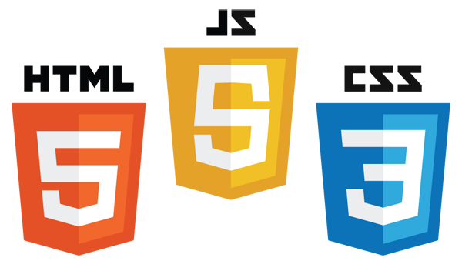
Extra Reference Stuff Follows

Slide 55
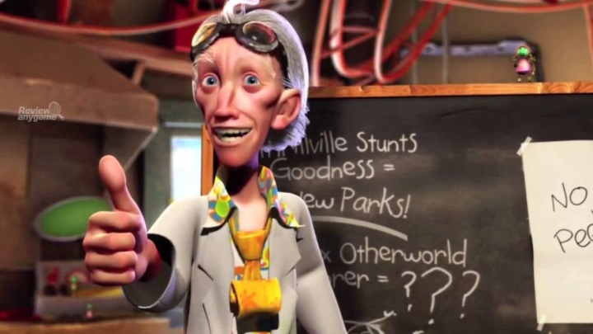
Credits
Much of the content derived/based on slides for use with the book:
Digital Image Processing, Gonzalez and Woods
Some layout and presentation style derived/based on presentations by
Donald House, Texas A&M University, 1999
Bernd Girod, Stanford University, 2007
Shreekanth Mandayam, Rowan University, 2009
Igor Aizenberg, TAMUT, 2013
Xin Li, WVU, 2014
George Wolberg, City College of New York, 2015
Yao Wang and Zhu Liu, NYU-Poly, 2015
Sinisa Todorovic, Oregon State, 2015
Beej’s Bit Bucket / Tech and Programming Fun
http://beej.us/blog/
http://beej.us/blog/data/html5s-canvas-2-pixel/
w3schools.com

