Slide 1

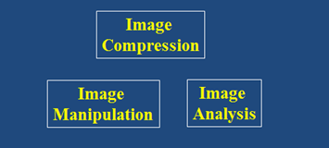


Warps, Filters, and Morph Interpolation
Brent M. Dingle, Ph.D. 2015
Game Design and Development Program
Mathematics, Statistics and Computer Science
University of Wisconsin - Stout
Material in this presentation is largely based on/derived from
slides originally by Szeliski, Seitz and Efros

Slide 2
Lecture Objectives
Previously
  Colors
  Filtering
  Interpolation
  Warps
Today
  Review
  Morphs

Slide 3
Outline
Review: Image Fundamentals
Review: Warping, Filtering, Interpolation
Image Morphing

Slide 4
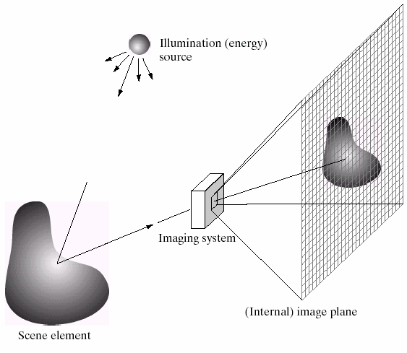
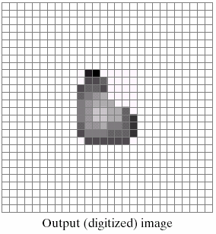
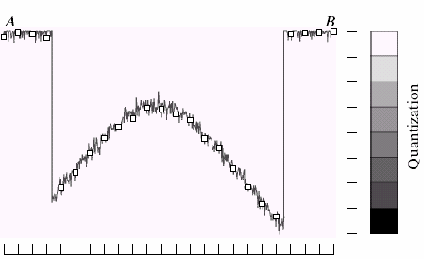
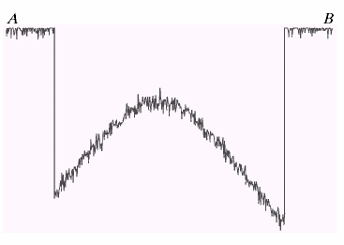
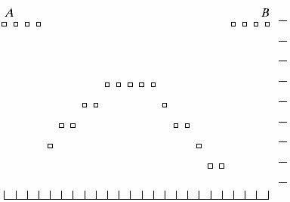
Image Formation
B
A

Slide 5
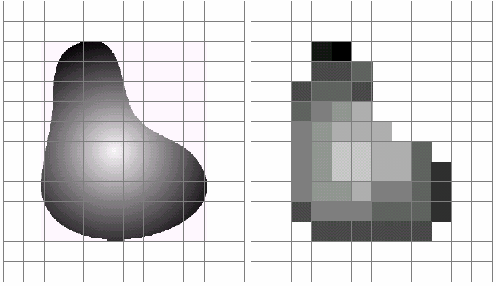
Sampling and Quantization

Slide 6
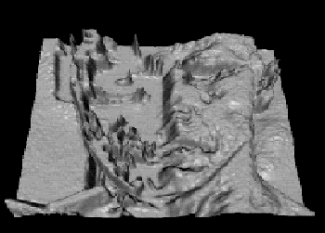
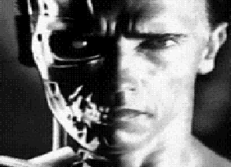
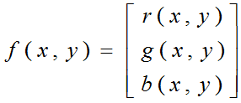
What is an Image?
2D Function or Array
  f(x, y) gives the pixel intensity at position (x, y)
  defined over a rectangle, with finite range
    f: [a, b] x [c, d] → [0, 1]
f
x
y
For color image f is a vector function:

Slide 7

Digital Image
Digital Images
  Sample the 2D space on a regular grid
  Quantize each sample (to nearest integer)
  Assume samples are D distance apart
    f[i, j] = quantize( f(iD, jD) )
  Image is now a matrix of integer values:

Slide 8
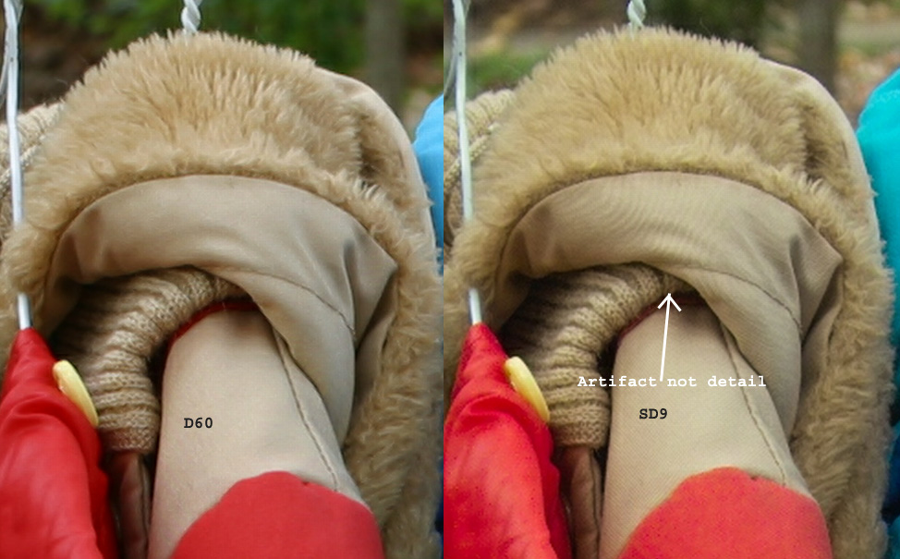
Images may have Aliasing Artifacts

Slide 9
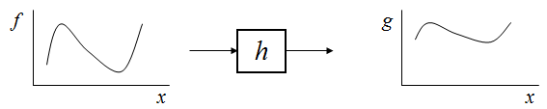
Image Manipulation
g(x) = h( f(x) )

Slide 10
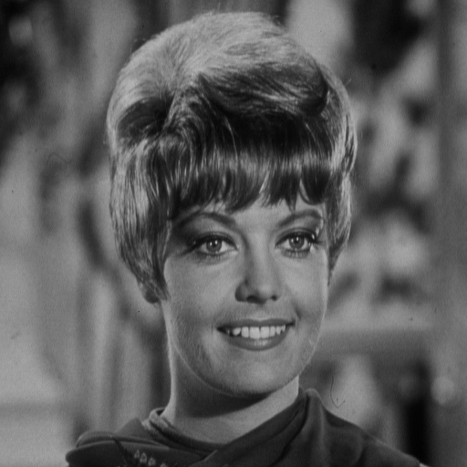
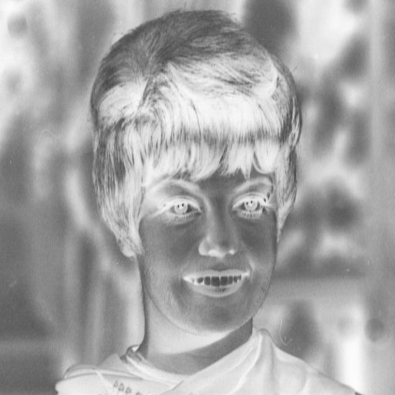
Point Processing Example
0
h(a) = 1 – a
Negative

Slide 11
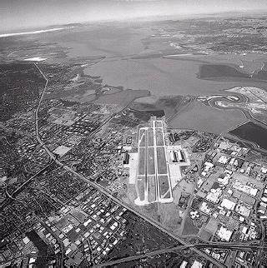
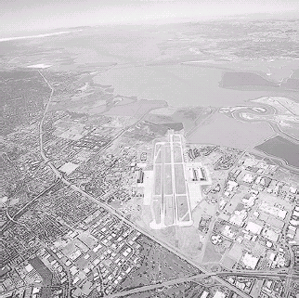
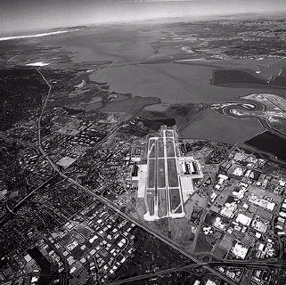
Image Enhancement Example
r=3
r=5
h(a) = a^{r}
gamma correction

Slide 12

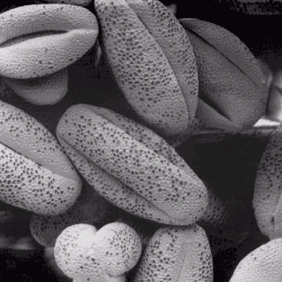
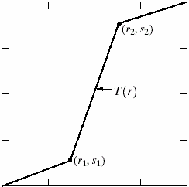
Contrast Stretching Example

Slide 13
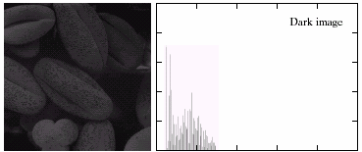
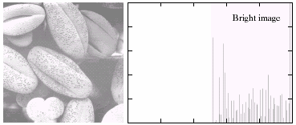
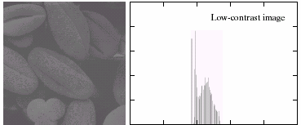
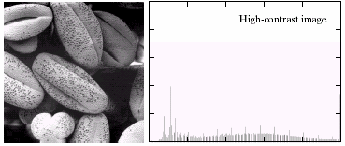
Histogram Analysis

Slide 14
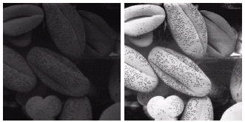
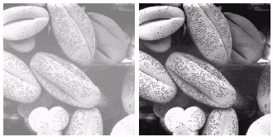
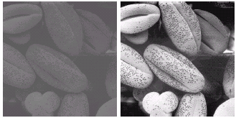
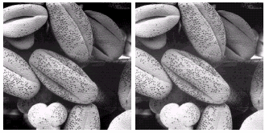
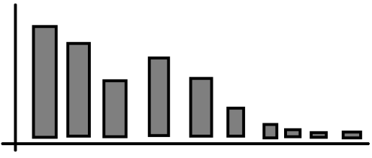
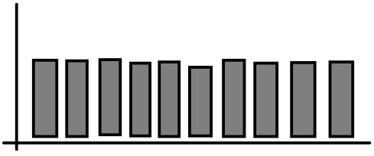
Histogram Equalization

Slide 15
Filtering (neighborhood processing)
‘Global-ness’ of histogram may be too big
  Example: Mix-up all the pixels
    Histogram stays same
    May need more locally spatial information for some operations to work as desired
      such as noise removal

Slide 16
Noise Examples

Slide 17
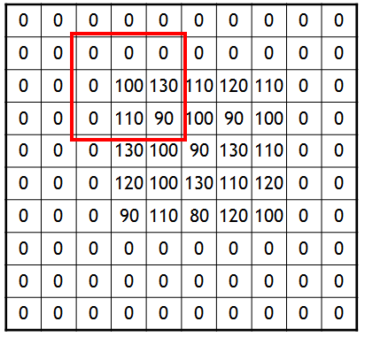
Noise Reduction
Mean, Median, and Gaussian filters
  local neighborhoods

Slide 18
Comparison: Salt and Pepper Noise

Slide 19
Outline
Review: Image Fundamentals
Review: Warping, Filtering, Interpolation
Image Morphing

Slide 20
Filtering and Warping: Review
Filtering
  modify an image based on image color content
  without any intentional change in image geometry
    resulting image essentially has the same size and shape as the original
Warping
  modification of an image that operates on the image’s geometric structure
Review follows…

Slide 21
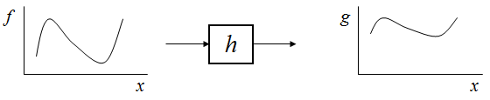
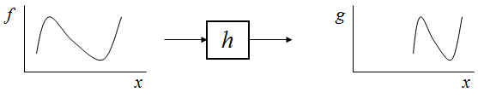
Image Filtering versus Warping
image Filtering: changes range of image
g(x) = h( f(x) )
image Warping: changes domain of image
g(x) = f( h(x) )

Slide 22
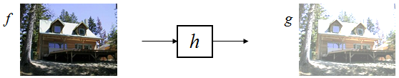
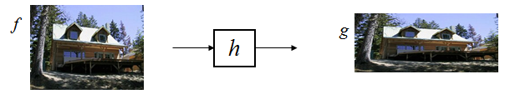
Image Filtering versus Warping
image Filtering: changes range of image
g(x) = h( f(x) )
image Warping: changes domain of image
g(x) = f( h(x) )

Slide 23



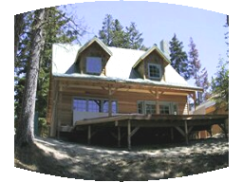

Parametric (global) warping
translation
rotation
aspect
perspective
affine
cylindrical

Slide 24
2D coordinate transforms
translation: x’ = x + t x = (x,y)
rotation: x’ = R x + t
similarity: x’ = s R x + t
affine: x’ = A x + t
perspective: x’ ≅ H x x = (x,y,1)
(x is a homogeneous coordinate)

Slide 25
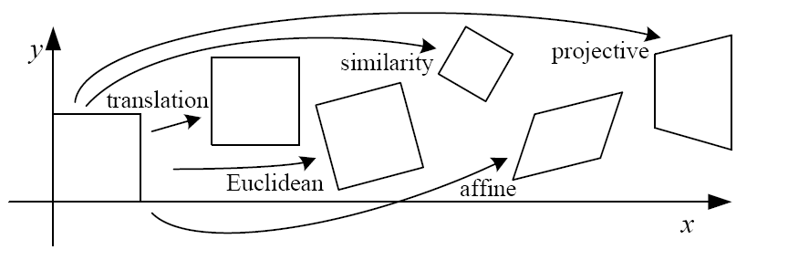
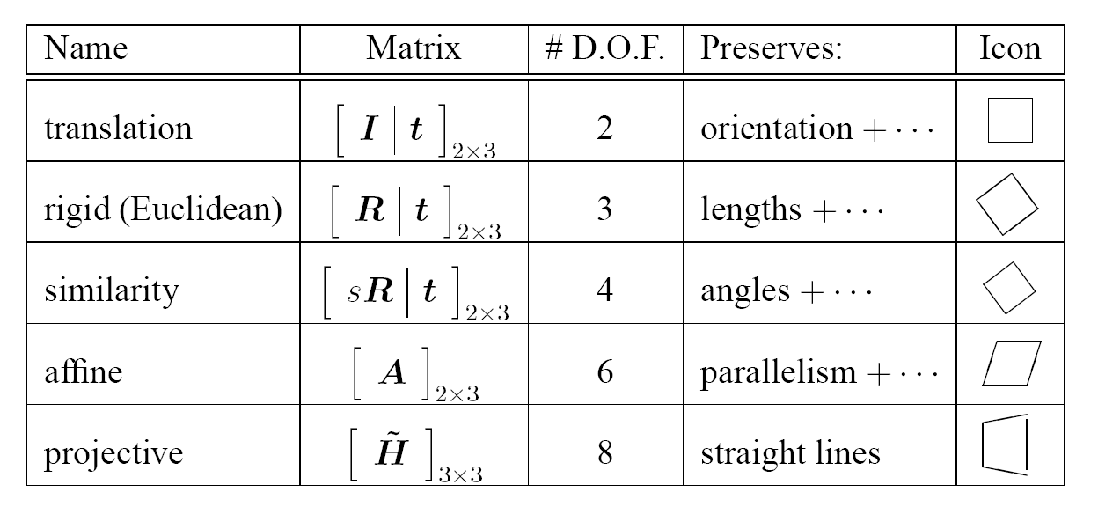
2D image transforms

Slide 26
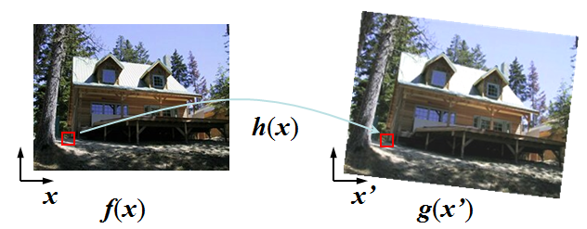
Image Warping
Given a coordinate transform x’ = h(x) and a source image f(x), how do we compute a transformed image g(x’) = f(h(x))?

Slide 27
Forward Mapping
Send each pixel f(x) to its corresponding location x’ = h(x) in g(x’)
  What if pixel lands “between” two pixels?

Slide 28
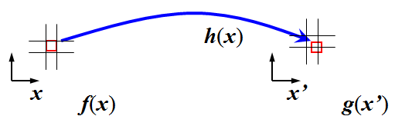
Forward Mapping
Send each pixel f(x) to its corresponding location x’ = h(x) in g(x’)
  What if pixel lands “between” two pixels?
    Answer: add “contribution” to several pixels, normalize later (splatting)

Slide 29
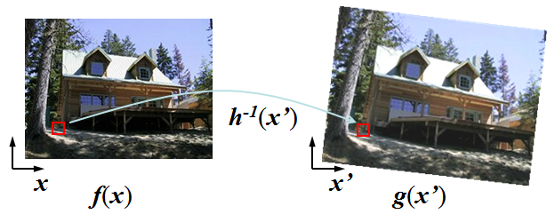
Inverse Mapping
Get each pixel g(x’) from its corresponding location x = h⁻¹(x’) in f(x)
  What if pixel comes from “between” two pixels?

Slide 30
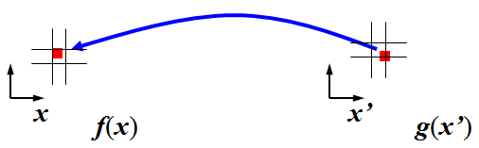
Inverse Mapping
Get each pixel g(x’) from its corresponding location x = h⁻¹(x’) in f(x)
  What if pixel comes from “between” two pixels?
  Answer: resample color value from interpolated (pre-filtered) source image

Slide 31
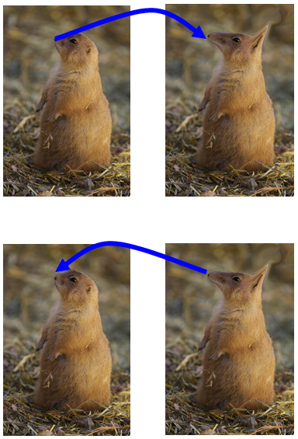
Forward versus Inverse
Forward Map
  Potential Gap Problems
Inverse Map
  Most useful
  For each output pixel
    Lookup at inverse warp location in input image

Slide 32
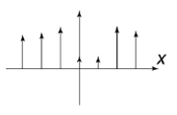
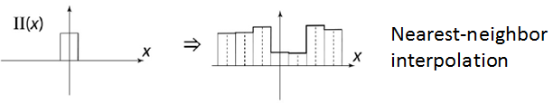
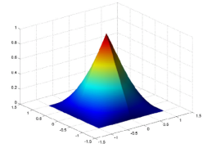
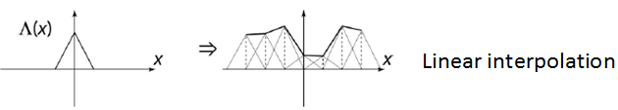
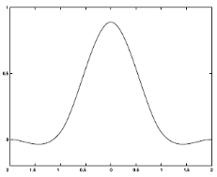
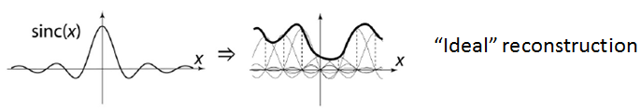
Interpolation
Given
Methods
  nearest neighbor
  bilinear
  bicubic
  sinc
Cubic interpolation

Slide 33
Nearest Neighbor
Given pixel (i’ , j’) in the destination image
Find the corresponding pixel in the source image (i, j)
EXAMPLE:
Assume source image has width = w, and height = h
Assume destination image has width = w’ and height = h’
Then a point in the destination is given by
i’ = i * w’ / w
j’ = j * h’ / h
integer division
so decimal portion
is dropped
Note: if using inverse mapping idea,
then you know i’ and j’ and must solve for i and j
So may be more useful to know i = i’ * w / w’
j = j’ * h / h’
PROBLEM: Aliasing in both enlarging and reducing image size
Slide based on: http://paulbourke.net/texture_colour/imageprocess/

Slide 34
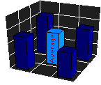
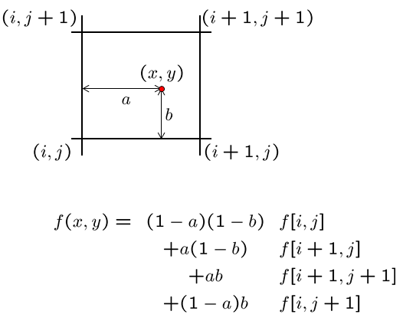


Bilinear Interpolation
(i’, j’) =
uses 4
pixel values
from original
image, f
Results are better than nearest neighbor
But there is still better

Slide 35




Bicubic Interpolation
Objective: Determine the color of every point (i’, j’) in the destination image
Point (i’, j’) of destination image corresponds to
a non-integer position in the source image → (x, y) =
where x = i*w’ / w
y = j*h’ / h
The nearest pixel coordinate (i, j) is the integer part of x and y
with dx = x – i and dy = y – j
the entire square is pixel at (i, j)
-- > 16 pixels are being used
Transformed
position of (i’, j’)
i.e. (x, y)
Recall Again
Inverse map idea:
i = i’ * w / w’
j = j’ * h / h’
Slide based on: http://paulbourke.net/texture_colour/imageprocess/

Slide 36



Bicubic Interpolation
Objective: Determine the color of every point (i’, j’) in the destination image
Point (i’, j’) of destination image corresponds to
a non-integer position in the source image → (x, y) =
where x = i*w’ / w
y = j*h’ / h
The nearest pixel coordinate (i, j) is the integer part of x and y
with dx = x – i and dy = y – j
the entire square is pixel at (i, j)
-- > 16 pixels are being used
Transformed
position of (i’, j’)
i.e. (x, y)
Recall Again
Inverse map idea:
i = i’ * w / w’
j = j’ * h / h’
Slide based on: http://paulbourke.net/texture_colour/imageprocess/

Slide 37
Outline
Review: Image Fundamentals
Review: Warping, Filtering, Interpolation
Image Morphing
  Cross Fading
  Feature Correspondence
    Warping Interpolation Options
      Splines
      Triangular Mesh
      Radial Basis Functions (RBFs)

Slide 38
More Recap: Morphing
Morphing is a special effect in animation that changes one image into another through a seamless transition
  Early methods used cross-fading techniques on film
  More common now
    Is a combination of generalized image warping with a cross dissolve between image elements
Morphing is a special effect in animation that changes one image into another through a seamless transition
  Early methods used cross-fading techniques on film
  More common now
    Is a combination of generalized image warping with a cross dissolve between image elements

Slide 39





Morph: Cross Fading/Dissolving
Averaging Images (an “easy” morph)
  Using the compositing equation
    C = αF + (1 - α)B
Image Morphing WITHOUT feature correspondence
Example code for this should be online: c015_crossfading

Slide 40

Morphing: Feature Correspondence
Input 2 images I₀ and I_{N}:
Output is image sequence I_{i}, with i = 1..N-1
User specifies sparse correspondences on the images
  Vector pairs: { (P_{j}⁰ , P_{j}^{N} ) }

Slide 41
Morphing: Feature Correspondence
For each intermediate frame I_{t}
  Interpolate feature locations P^{t}_{i}= (1- t) P⁰_{i} + t P¹_{i}
  Perform two warps: one for I₀, one for I₁
    Deduce a dense warp field from the pairs of features
    Warp the pixels
  Linearly interpolate the two warped images
crossfade
warp 1
warp 2
morph with
feature
correspondence
Linear
Interp

Slide 42


Example: Input Images
Slide derived/taken from presentation of Fredo Durand and Bill Freeman

Slide 43


Feature Correspondences
Feature locations are the 2D vector points: y_{i}.
Slide derived/taken from presentation of Fredo Durand and Bill Freeman
Notes:
Beier, T. & Neely, S. (1992). "Feature-based image metamorphosis" (PDF). Computer Graphics 26 (2): 35–42. doi:10.1145/133994.134003

Slide 44

Interpolate Feature Locations
Interpolate between the 2D vectors
  Provides the 2D vector points: x_{i} .
Slide derived/taken from presentation of Fredo Durand and Bill Freeman

Slide 45


Warp Each Image to Intermediate Location
Two DIFFERENT warps
Same target location
but different source location
The x_{i} are the same
(intermediate locations)
The y_{i} are different
(source feature locations)
The y_{i} do NOT change
throughout the animation
BUT
the x_{i} are different for each
intermediate image
Images shown are for t = 0.5
-- the y_{i} are in the middle
Slide derived/taken from presentation of Fredo Durand and Bill Freeman

Slide 46


Warp each image to Intermediate Locations
Slide derived/taken from presentation of Fredo Durand and Bill Freeman

Slide 47


Linearly Interpolate Colors
Interpolation weights
are a function of time
$$C=\left(1−t\right){f^{0}}_{t}\left(I_{0}\right)+t{f^{1}}_{t}\left(I_{1}\right)$$
Slide derived/taken from presentation of Fredo Durand and Bill Freeman

Slide 48
Feature Summary So Far
For each intermediate frame I_{t} :
  Interpolate feature locations
    y^{t}_{i} = (1-t)x⁰_{i} + tx¹_{i} .
  Perform two warps: one for I₀ and one for I₁
    Calculate a warp field from the feature pairs
    Warp the pixels
  Linearly interpolate the two warped images

Slide 49
Warp Options
Feature Point to Feature Point
  But how exactly do those warps work?

Slide 50

Warp Options: non-parametric
Move control points to specify a spline warp
Spline produces a smooth vector field
Slide Alyosha Efros

Slide 51

Warp Specification – too dense
We could specify all the spline control points
  Interpolate to complete a warping function
But we really want to specify only a few points – not the entire grid

Slide 52

Warp Specification – too dense
We should instead specify corresponding points
  Interpolate to complete a warping function
How do we do it?
How do we go from feature points to pixels?

Slide 53

Triangular Mesh of Images
Input correspondences at key feature points
Define a triangular mesh over the points
  Use SAME MESH for both images
  Provides triangle-to-triangle correspondences
Warp each triangle separately from source to destination
Slide Alyosha Efros

Slide 54

Morphing: Triangle Method
Feature points are marked on source and target images
  i.e. correspondence points identified
Points are use to form triangles
Triangulation is interpolated for intermediate frames
Images are warped based on the interpolation of points
Colors are blended (as in crossfade)

Slide 55

Morphing: Triangle Method
Interpolation is in the triangular domain
  How is P related to P₁, P₂, and P₃ ?

Slide 56

Morphing: Triangle Method
Interpolation is in the triangular domain
  How is P related to P₁, P₂, and P₃ ?
P = uP₁ + vP₂ + wP₃ .
A = area of triangle
u = A₁ / A
v = A₂ / A
w = A₃ / A
u, v, w: Barycentric coordinates

Slide 57


Triangulation Morphing: Problems
Not very continuous – only C⁰.
Folding problems
Fig. L. Darsa

Slide 58
Desires of Warp Interpolation
Looking for a warping field
  A function that given a 2D point
  returns a warped 2D point
Only have a sparse number of correspondence points
  These points specify values of the warping field
This is an interpolation problem
  Given sparse data, find a smooth function

Slide 59
Interpolation in 1D
Looking for a function f
Have N data points: x_{i}, y_{i} .
  Scattered points → spacing between x_{i} is non-uniform
Desire f such that
  For each i, f(x_{i}) = y_{i}
  f is smooth
What “smooth” means can yield different f

Slide 60
Radial Basis Functions (RBF)
Place a smooth kernel R
centered on each data point x_{i}
f(z) = Σα_{i} R(z, x_{i} )
  Find weights α_{i} to so f(x_{i}) = y_{i} for all i.

Slide 61
Radial Basis Functions (RBF)
Place a smooth kernel R
centered on each data point x_{i}
f(z) = Σα_{i} R(z, x_{i} )
  Find weights α_{i} to so f(x_{i}) = y_{i} for all i

Slide 62

Kernel Choices
Many choices for what kernel function to use
An option to use is an inverse multi-quadric
Notice c controls falloff
Easy choice is to pick a constant c for every kernel
Better option
For each kernel select a unique c such that
c is the squared distance to the nearest other x_{j}.

Slide 63

Other Kernel Options
Gaussians
  $$e^{{−r}^{2}/2σ}$$
Thin plate splines
  $$r^{2}\log{r}$$
        Aside:
          May want or need to add a global polynomial term

Slide 64
Applying the Interpolation
f(z) = Σα_{i} R(z, x_{i} )
N equations
  for each j, f(x_{j}) = y_{j}
  y_{j} = Σα_{i} R(z, x_{i} )
N unknowns: α_{i} .
  Invert the matrix

Slide 65
Differences of Methods
f(z) = Σα_{i} R(z, x_{i} )
Note, at a given data point
the influence of each function is NON-ZERO EVERYWHERE
→ the values of the other bases are not zero
This is different from interpolation splines
→ know the neighborhood of influence

Slide 66
Recap: 1D Scattered Data Interpolation
Sparse input/output pairs: x_{i}, y_{i}.
  non-uniform sampling
Radial Basis Functions (RBFs)
  Weighted sum of kernels R centered at data points
    f(z) = Σα_{i} R(z, x_{i} )
  Compute the weights α_{i}, by enforcing interpolation
    f(x_{j}) = y_{j} .
    Simple linear system

Slide 67

RBF warping: 2D case
Think vector functions
  f was R→R, is now R² → R² .
Still have N data points
  x_{i} and y_{i} are now 2D vectors
  Use 2D kernels at each data point (think cone-like)
  The weights, α_{i}, are also 2D vectors
Solve a linear system of
2N equations and 2N unknowns

Slide 68


Example
Still may have folding problems…

Slide 69
RBF: Further Investigation
Students are encouraged to perform further investigations using RBFs
  Contrasting with the spline interpolation methods
  Discover other applications/uses of RBFs
de Boor, C. (1978).
A practical guide to splines, New York: Springer
Verlag.
Davis, P J (1975).
Interpolation and Approximation Dover, New York.
Brenner, S and Scott, L (1994).
The mathematical theory of finite elements
Springer, New York.
Turk,G.and O’Brien, J. 1999. Shape transformation using
variational implicit functions. Computer Graphics Proceedings,
Annual Conference Series (SIGGRAPH 1999), 335–342.
Bishop, C.M. (1995).
Neural networks for pattern recognition,
Oxford: Clarendon Press.
Witkin,A.P. And Heckbert, P.S. 1994. Using particles to sample
and control implicit surfaces. Computer Graphics Proceedings,
Annual Conference Series (SIGGRAPH 94), 269–278.
Powell, M J D (1997).
A new iterative algorithm for thin plate spline
interpolation in two dimensions, Annals of
Numerical Mathematics 4: 519-527.
Buhmann, Martin D. (2003),
Radial Basis Functions: Theory and Implementations,
Cambridge University Press
Many others…
Notes:
Another direction might include:
Kohonen, T. (1990).
The self-organizing map. Proc. IEEE, 78(9), 1464-1480.

Slide 70
Outline
Review: Image Fundamentals
Review: Warping, Filtering, Interpolation
Image Morphing
  Cross Fading
  Feature Correspondence
    Warping Interpolation Options
      Splines
      Triangular Mesh
      Radial Basis Functions (RBFs)
      Other options

Slide 71
From Points to Lines
Point based features can triangulate image areas
  Triangle interpolation has folding issues
  RBF interpolation also has folding issues
Other options?
  Line based features also can be used
Beier, T & Neely, S. (1992). Feature-based image metamorphosis
Computer Graphics 26 (2): 35-42. doi: 10.1145/133994.134003
See also a contrast paper at:
http://airccse.org/journal/sipij/papers/2411sipij20.pdf
Bhatt Bhumika, G (2011).
Comparative Study of Triangulation based and Feature based Image Morphing
Signal & Image Processing: An International Journal (SIPIJ) Vol.2, No.4, Dec 2011.

Slide 72

So Again: Morphing
Morphing is a special effect in animation that changes one image into another through a seamless transition.
  Early methods used cross-fading techniques on film
  More common now
    Is a combination of generalized image warping with a cross dissolve between image elements
public domain images from wikimedia commons
https://commons.wikimedia.org/wiki/File:Bush-Arnie-morph.jpg
Check out the book: http://www-cs.engr.ccny.cuny.edu/~wolberg/diw.html

Slide 73
Feature Summary So Far
For each intermediate frame I_{t} :
  Interpolate feature locations
    y^{t}_{i} = (1-t)x⁰_{i} + tx¹_{i} .
  Performa two warps: one for I₀ and one for I₁
    Calculate a warp field from the feature pairs
    Warp the pixels
  Linearly interpolate the two warped images
These
warps
require
attention
warp 1
warp 2

Slide 74



Line Pair Option
May also morph using line pairs
  instead of point pairs
Beier, T & Neely, S. (1992). Feature-based image metamorphosis
Computer Graphics 26 (2): 35-42. doi: 10.1145/133994.134003

Slide 75



Multiple Line Pairs
See also: http://www.hammerhead.com/thad/morph.html

Slide 76
Challenge
Challenge 1
  Implement a program to crossfade 2 input images
    Display crossfade animation
Challenge 2
  Implement a program to allow the user to select features on 2 different images to morph between
    Display morphing animation
      Suggest using line-based algorithm first
      Then try point-based (with triangulation then RBF)

Slide 77
Outline
Review: Image Fundamentals
Review: Warping, Filtering, Interpolation
Image Morphing
  Cross Fading
  Feature Correspondence
    Warping Interpolation Options
      Splines
      Triangular Mesh
      Radial Basis Functions (RBFs)
      Other options

Slide 78
Questions?
Beyond D2L
  Examples and information
  can be found online at:
    http://docdingle.com/teaching/cs.html
    Continue to more stuff as needed

Slide 79
Extra Reference Stuff Follows

Slide 80




Slide 81



Slide 82




Slide 83


Slide 84

Nearest Nhbr Interp

Slide 85

Bilinear Interp

Slide 86

Bicubic Interp

Slide 87


Slide 88



Credits
Much of the content derived/based on slides
for use with the book:
  Digital Image Processing, Gonzalez and Woods
Some layout and presentation style derived/based
on presentations by
  Donald House, Texas A&M University, 1999
  Bernd Girod, Stanford University, 2007
  Shreekanth Mandayam, Rowan University, 2009
  Igor Aizenberg, TAMUT, 2013
  Xin Li, WVU, 2014
  George Wolberg, City College of New York, 2015
  Yao Wang and Zhu Liu, NYU-Poly, 2015
  Sinisa Todorovic, Oregon State, 2015

