Slide 1
WELCOME to GDD 325
Your New Job
Brent M. Dingle, Ph.D. 2016
Game Design and Development Program
Mathematics, Statistics and Computer Science
University of Wisconsin - Stout

Slide 2
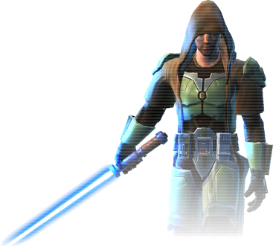
Instructor
Brent Dingle, Ph.D.
Office: JHSW, Room 219
Office Hours:
TBA
Office Phone: N/A
Email: dingleb@uwstout.edu
Experience
2013- : University of Wisconsin - Stout
2012-2013: Kihon Games
2007-2012: Raytheon Missile Systems
1997-2007: Texas A&M University – College Station
1995-1997: Customer Development Corporation
1994-1995: Caterpillar
1990-1995: Bradley University
Raytheon Advertising Video circa 2014 or earlier

Slide 3
In Case of Emergency
Locate the exit door
Note the exit paths
If the door cannot be located
it’s too late

Slide 4
Welcome
Welcome to Your New Job in 2D Game Design and Development!
Let’s begin with an overview of what this job entails…

Slide 5
Company Vision Statement
To achieve greatness and affect the world in a positive way through dedication, commitment, and creative construction of meaningful games

Slide 6
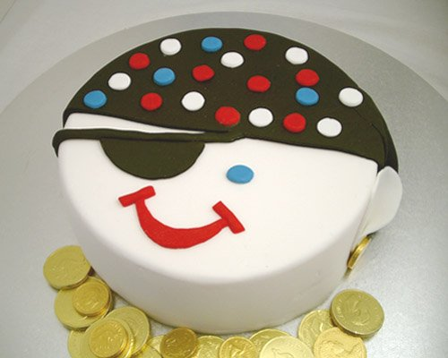
Employee Benefits
Experience working for a Client
Experience working as a Team
Exercise Presentation Skills
Become familiar with approaching design and development from a System Level Perspective
plus much, much, more!

Slide 7
The Subtle Benefits
This is about more than just making a game
You have an opportunity
learn to work as a member of a team in a professional manner
You should practice and improve many of your ‘soft’ skills
Engaging and interacting with others
Evaluating your own work
Estimating time to completion
Professionally responding to criticism
Evaluating the work of others
Giving useful/constructive feedback to others
Managing workload (meeting deadlines)
Responding to dynamic change
Being accountable for what you say you will do (and when)
and more…

Slide 8
Retirement Plan
None Available
HR is working hard to find more options

Slide 9
Work Ethic
Take responsibility
for what you do
and for what you do not do
Trust and Believe in yourself
so your teammates can too
Never Lie, Never Cheat, Never Steal
Do not tolerate those who do
Elaboration, Collaboration, and Borrowing
can be acceptable

Slide 10
Vacation Days
None
So don’t get sick =)
Missing class will result in a reduction of your evaluation score
Special consideration can be given
In the event you know you will be gone
Consult with management BEFORE being absent

Slide 11
Tools
This lab
Plus
Whatever else a team agrees to use and has access to

Slide 12
Your Job Description
Work on small independent assignments
very few in number
Complete a game project for a client

Slide 13
Pay Scale
You work for free
You volunteered for this

Slide 14
Work Evaluation
You will be evaluated by
Your Instructors
Your Client
Your Peers

Slide 15
Assignments
Individual Assignments will be given later
on a need-to-know basis
will include
personal webpage online
resume (available from your webpage)
written essay papers
Most of your time will be on a Team Project
Designing and Developing a Game

Slide 16
Project General Setup
Coding
HTML5
Canvas
JavaScript
CSS (Cascading Style Sheets)
try to keep these “minimally used”
Artwork
PNG, JPEG, maybe GIF
Background Images, Sprites, Sprite sheets, Textures…
Transparent and/or layered images may be needed

Slide 17
Project Target Platforms
Default: Firefox
Desired: Firefox, Chrome, Safari, IE
Bonus: Mobile Device Versions of those Browsers
Check with client for what is Needed

Slide 18
General Work and Project Info
Client based game
You will be assigned a team, and your team will be assigned a client
The project is typically
A 2D environment
Educational (serious) in Nature
A game with a purpose beyond the game itself
So always consider
How and why will it be educational?
How will you test the educational aspects?

Slide 19
Implicit Product Requirements
Your client project MUST work online
It MUST BE tested online
It MUST BE released online
Each team will be expected to solve this ‘problem’
Solution must be instructor approved
Version control
Decision on how is the team’s responsibility
System must be instructor approved

Slide 20
So Who’s in Charge?
Clients have the Game Project Vision
Student Teams
Design and Develop the game
Following the guiding vision of the client
Course Instructors have
Final say on everything
Control of process

Slide 21
Organizational Chart
Client
Client
GDD Instructors
Client
Client
Team 1
Team 2
Team 3
Team 4
Students

Slide 22
General Work Schedule/Deadlines
Project work will be divided into Sprints
Sprints are 1 to 3 weeks in duration
Usually ending on Mondays
BUT
EVERY WEEK
Meet with your client
AND
Every Sunday
Have a working build

Slide 23
Near Future: Tentative Schedule
class 2 | Self-Presentation
 | Professional, about 3 minutes
class 3 | Pitch-It Assignment
 | Individuals create and turn in an Inception Doc on an Assigned Game
class 8 | Paired Prototype
 | Each of you will have been paired with someone Each team will have been given two game options and selected one. The team creates a mockup and prototype and a presentation, plus evaluations on each other. All due on this date
class 8 | Also on this day: Teams and clients should be announced
CAUTION: Actual dates will vary from semester to semester
and the paired prototype may range from class 7 to 9

Slide 24
Point to Note
Homework:
Next Class have a presentation on yourself
circa 3 minutes, Focus on:
Why should someone want to work with you/hire you
what have you done
what do you like doing/good at doing
Turn in PowerPoint to D2L dropbox before class
also bring laptop to class with presentation on it
MAC users note the need for video converter to plug into projector
See D2L Assignments folder and files for more details

Slide 25
Note on Grading
To encourage Active Participation in Teams
You will have 2 grades
Team(s) Grade
The general/overall grade for the team product(s)
Individual Grade
The individual’s contribution/effort/… to make the team product(s)
Includes peer evaluations
Also receives a small bump upwards from the individual based assignments (pitches, papers…)
ASIDE: It is unlikely but possible for every individual to score below the team’s product grade…
it’s called a ‘lucky’ turn of circumstances/outcome of product.
The opposite is also possible and is called ‘unlucky’ – commonly caused by a bad presentation

Slide 26
Note on Grading
At the end of the semester
if Individual Grade < Team Grade
then Final Grade = Individual Grade
if Individual Grade >= Team Grade
then Final Grade = average of (Individual and Team)
Worked below the average of your team
Worked above the average of your team
In sum
You want to over-achieve your teammates
and they likewise…
thus everybody works (tries hard)
and individuals do better AND team does better

Slide 27
End Summary
This will be the BEST JOB EVER
until gdd 450
Make friends with ALL your classmates/coworkers

Slide 28
Questions?
Beyond D2L
Examples and information can be found online at:
http://docdingle.com/teaching/gdd325/
Continue to more stuff as needed

